Slide 1
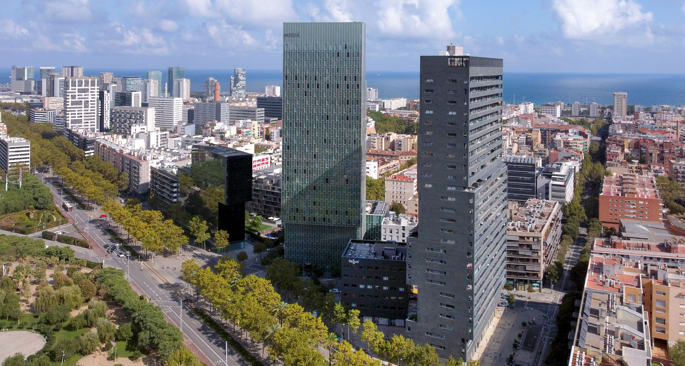
Meliá Barcelona Sky

Slide 2
Content
01
04
Rooms and Suites
Power Meetings
02
05
The Level
Other Facilities
03
Gastronomic Experience

Slide 3
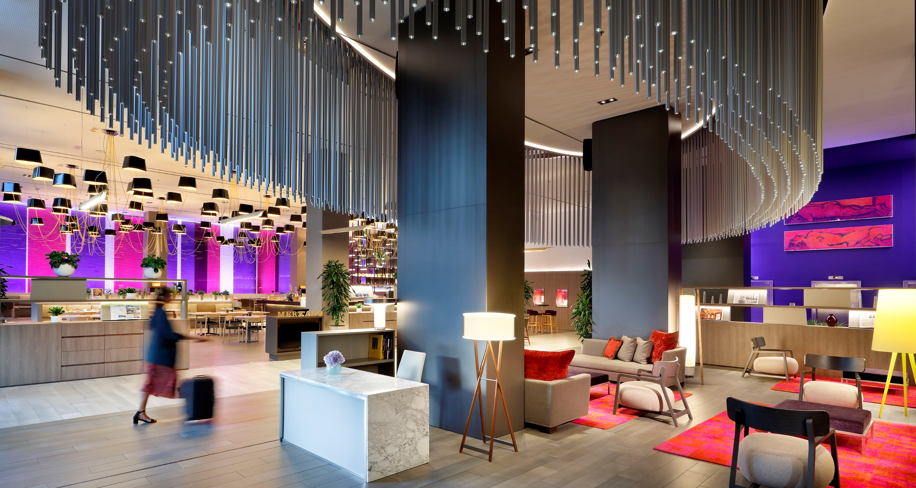

Slide 4
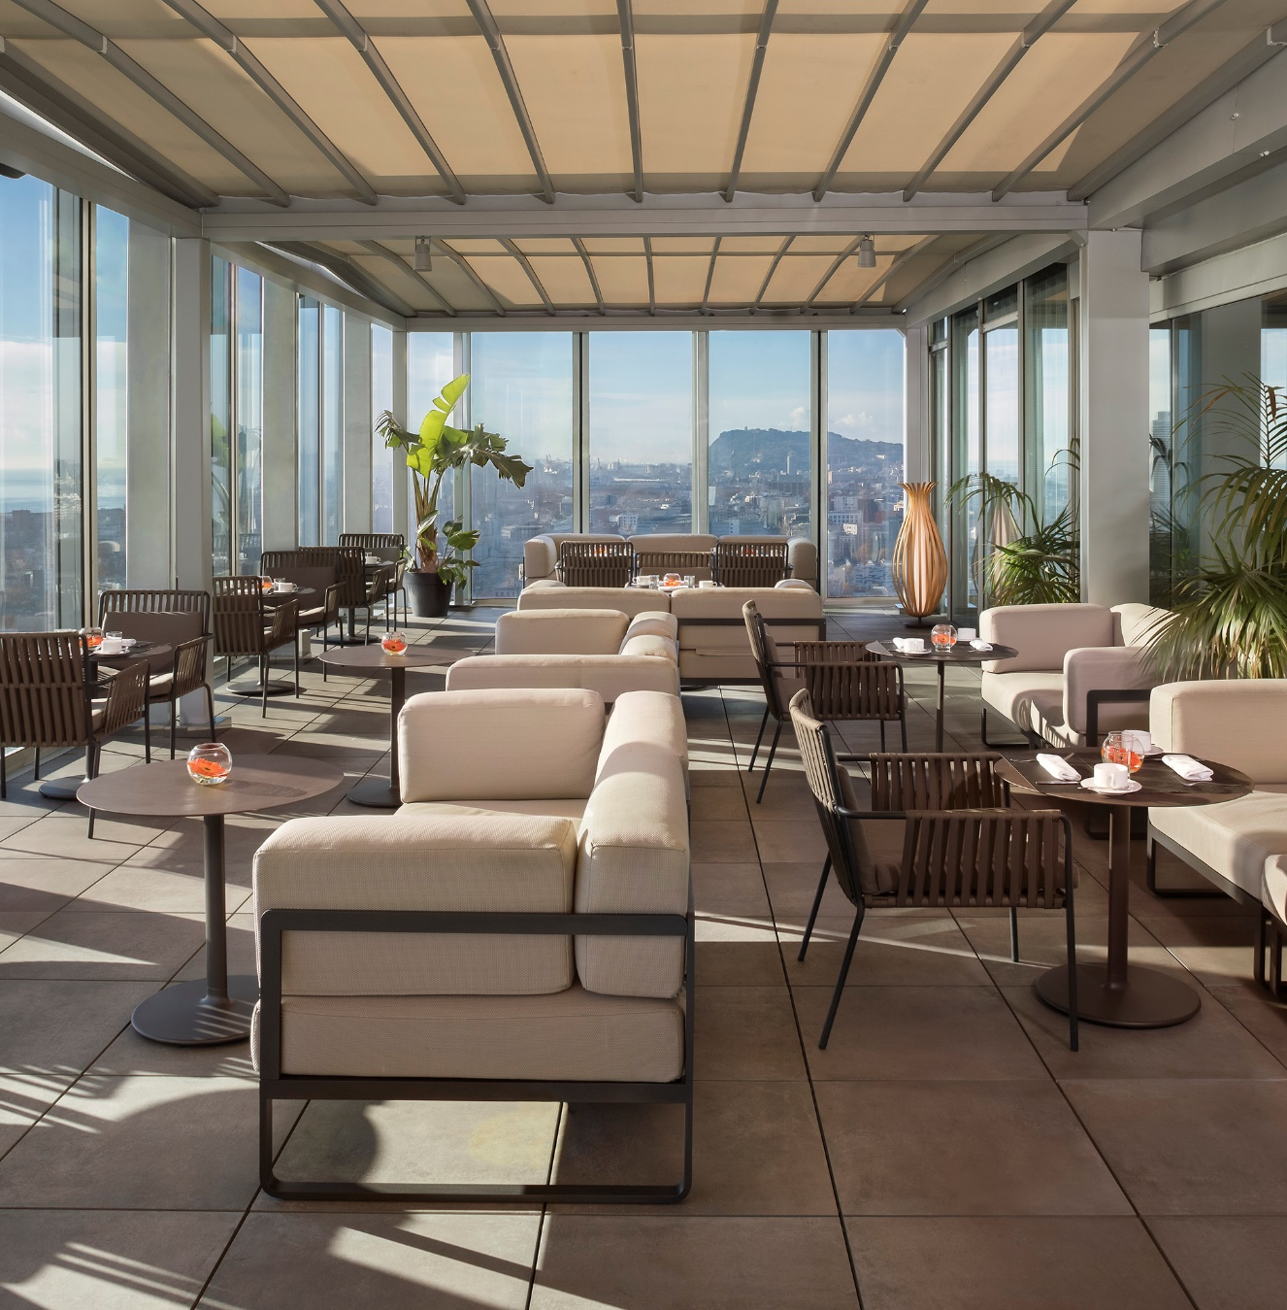
Incredible views of the Mediterranean
MELIÁ BARCELONA SKY
An iconic building that offers spectacular views of the Mediterranean Sea and the city of Barcelona. Located in the ‘22@ District,’ known for technology and innovation, it is close to one of the city’s best and most peaceful beaches.

Slide 5
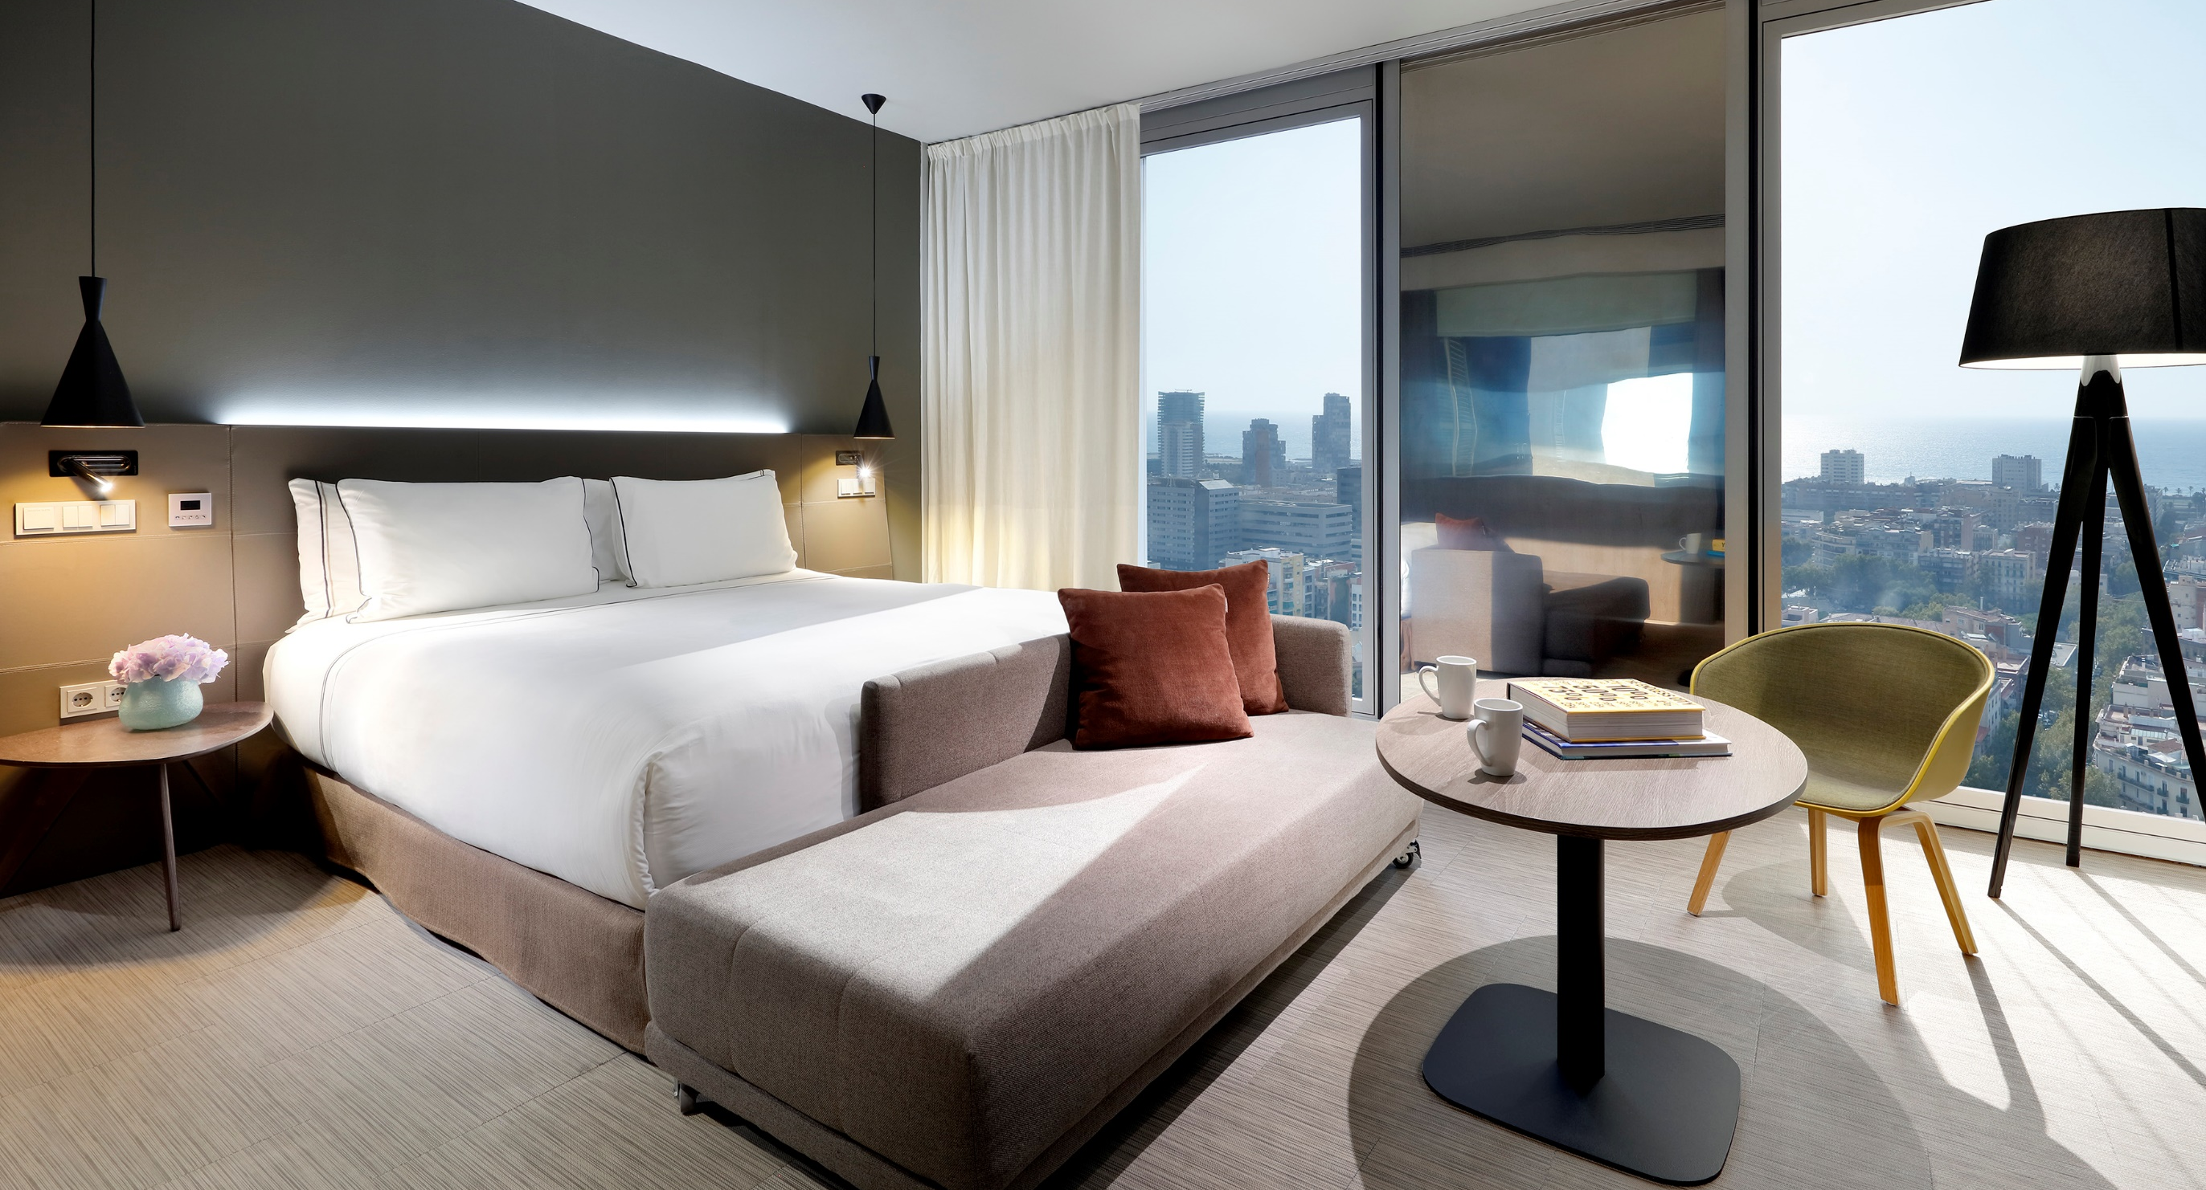
01
Rooms and Suites

Slide 6
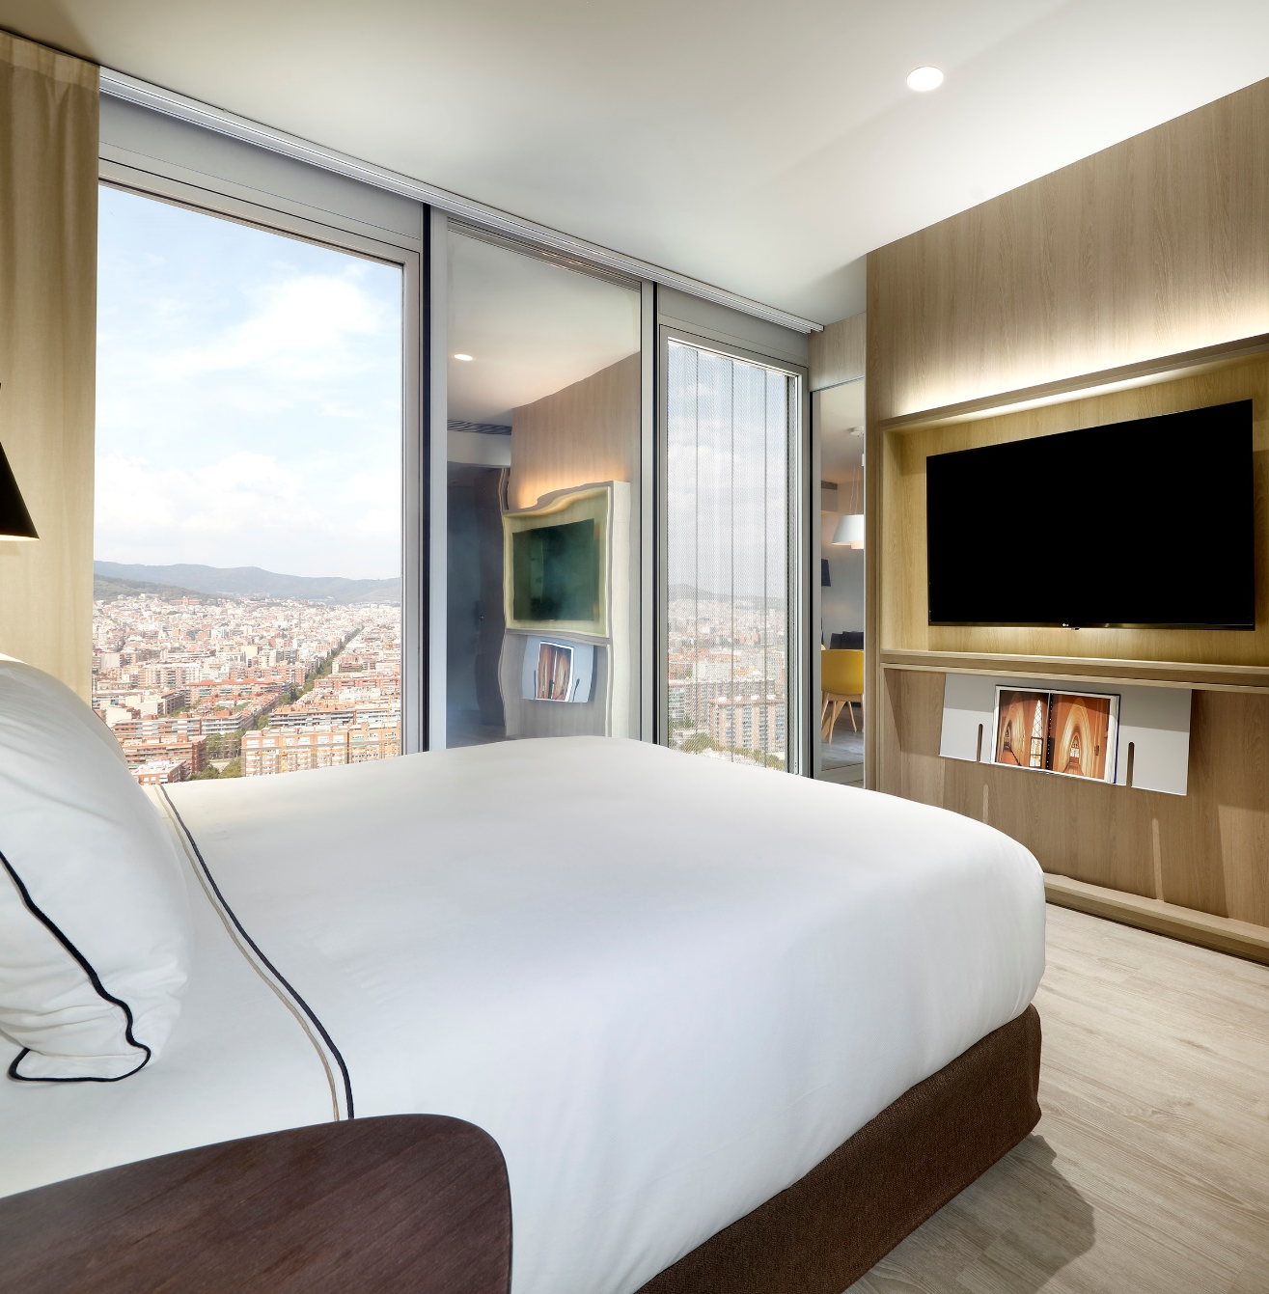
Elegant and comfortable rooms
MELIÁ BARCELONA SKY
Meliá Barcelona Sky features 261 spacious, elegant, and bright rooms, including 23 suites and The Level Service. Each room is equipped with state-of-the-art technology to ensure guests feel as comfortable as possible during their stay.
All rooms are designed with a modern and functional style, maximizing natural light to meet guests' needs in an exclusive and comfortable environment.
Each room is outfitted with high-quality, spacious bathrooms, featuring double rain-effect showers and bathtubs.

Slide 7
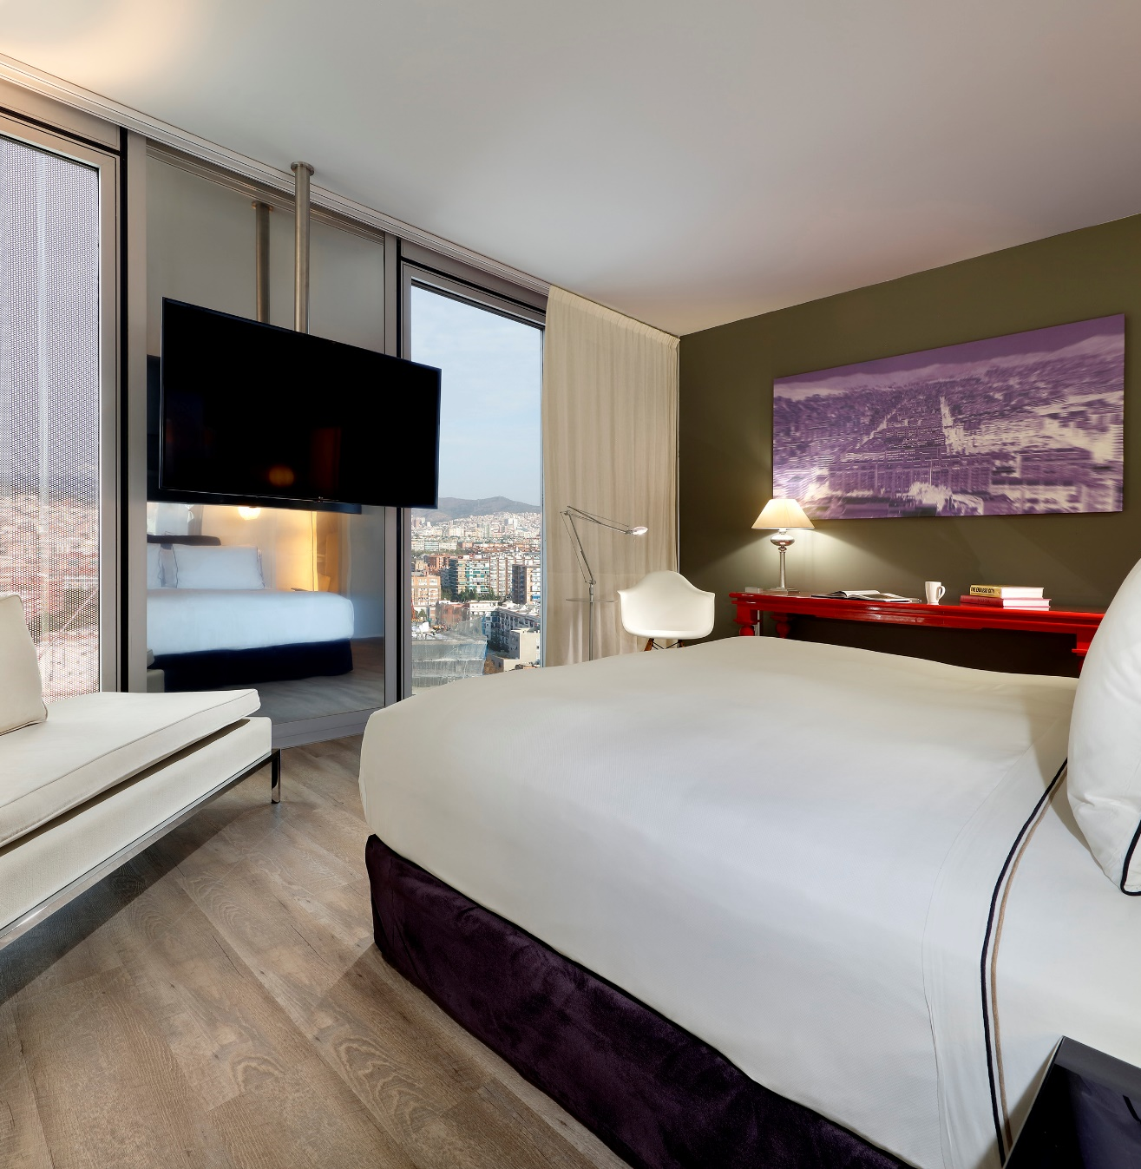
Meliá Room
MELIÁ BARCELONA SKY
1 King-size bed or two single beds | 25 m² – Option for a family room (2 connecting rooms | 50 m²). Total of 56 rooms.
This avant-garde design room features two large windows offering the best views of Barcelona. It is equipped with a King-size bed or two single beds and a bright bathroom with a rain-effect shower.

Slide 8
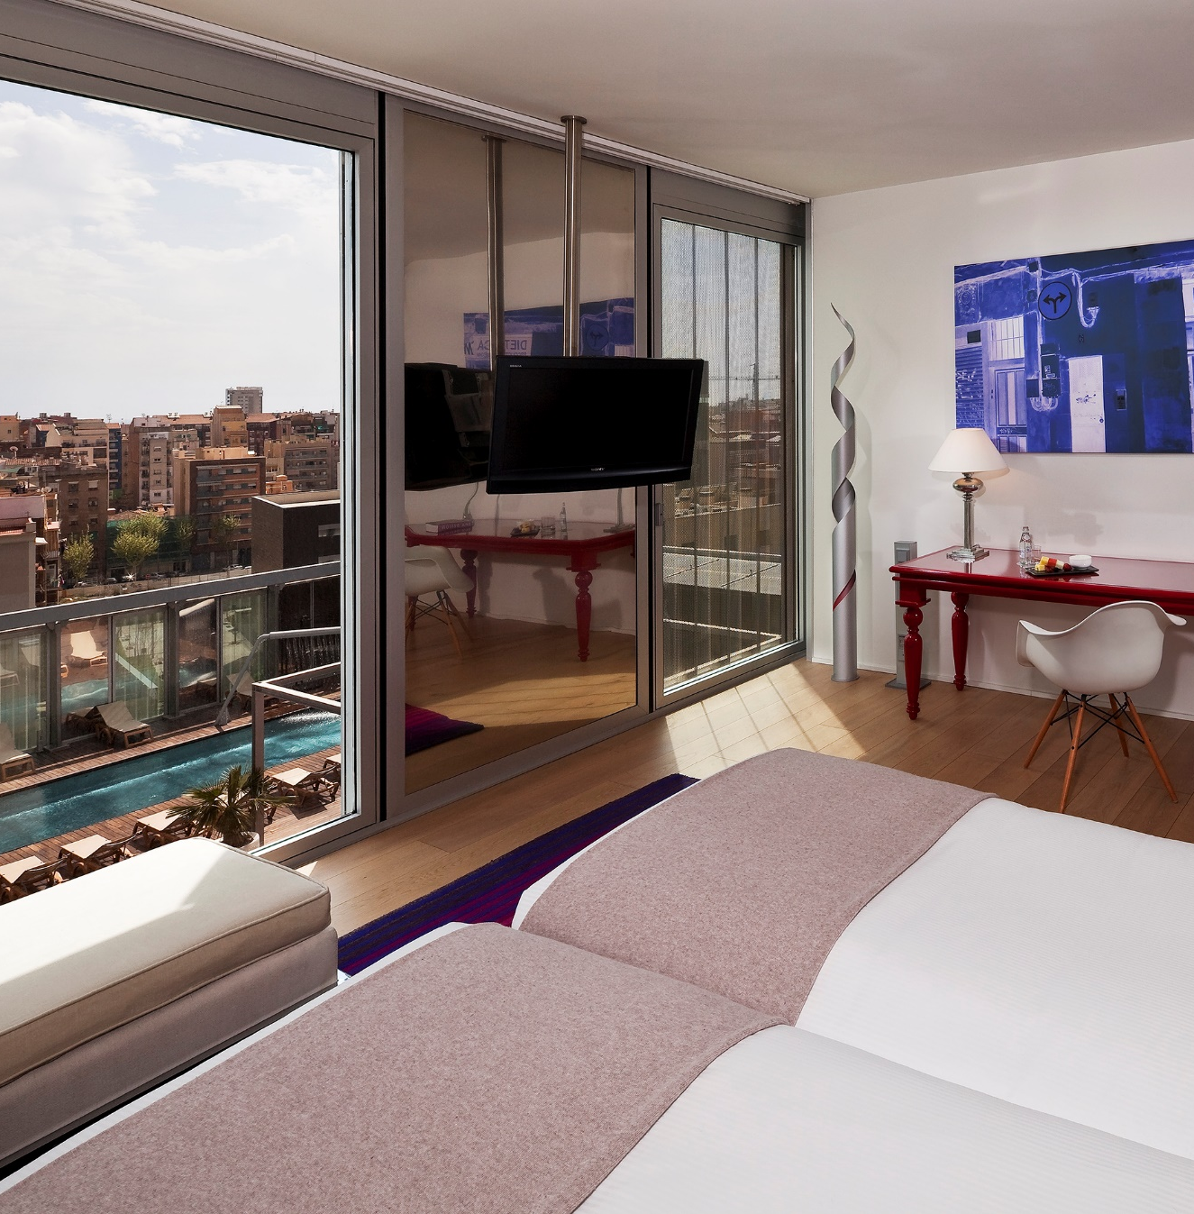
Meliá Room Pool View
MELIÁ BARCELONA SKY
1 King-size bed or two single beds | 30 m² – Option for a family room (2 connecting rooms | 60 m²). Total of 35 rooms.
This room will captivate you with its delightful views of the pool. It boasts a modern design and ample natural light, thanks to soundproof floor-to-ceiling windows.

Slide 9
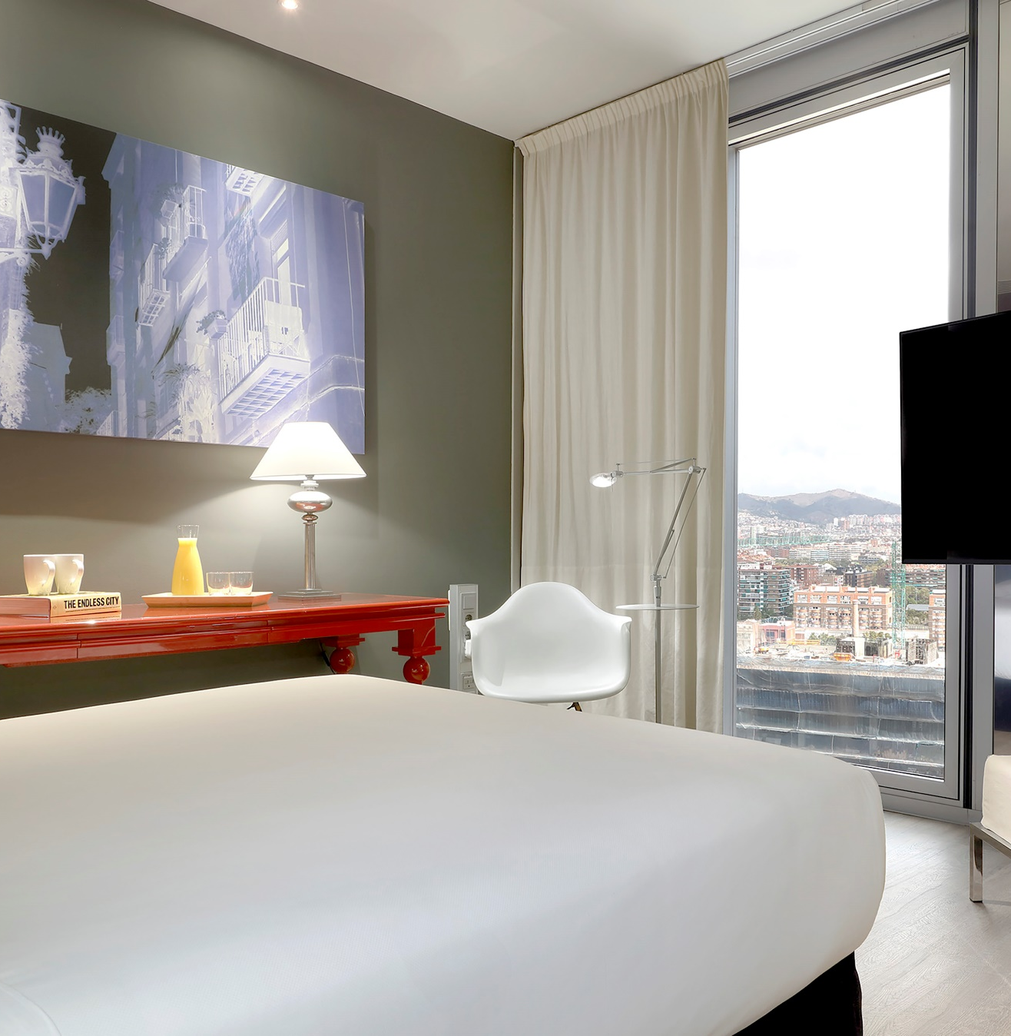
Premium Room City View
MELIÁ BARCELONA SKY
1 King-size bed or two single beds | 25 m². Total of 28 rooms.
With stunning views of Barcelona, discover this shelter located from the 14th floor upwards. A modern and light-filled stay featuring soundproof windows that guarantee complete rest and relaxation.

Slide 10
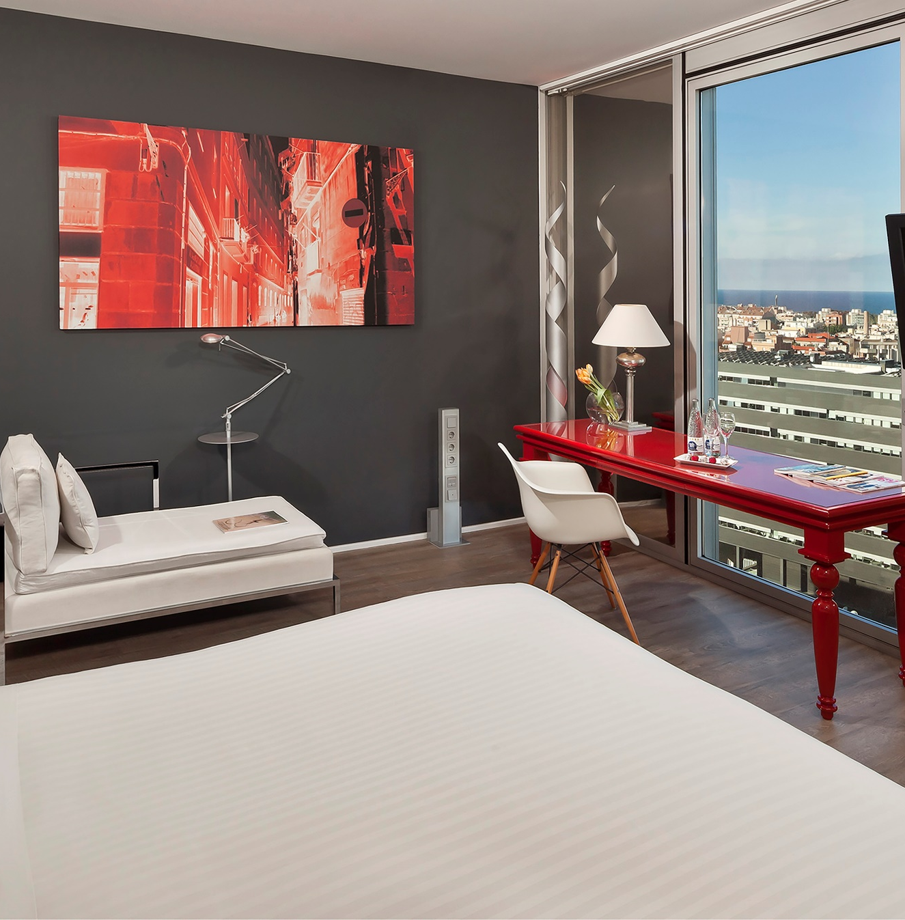
Premium Room Sea View
MELIÁ BARCELONA SKY
1 King-size bed or two single beds | 30 m² – Option for a family room (2 connecting rooms | 60 m²). Total of 14 rooms.
Breathtaking panoramic views of the Mediterranean.

Slide 11
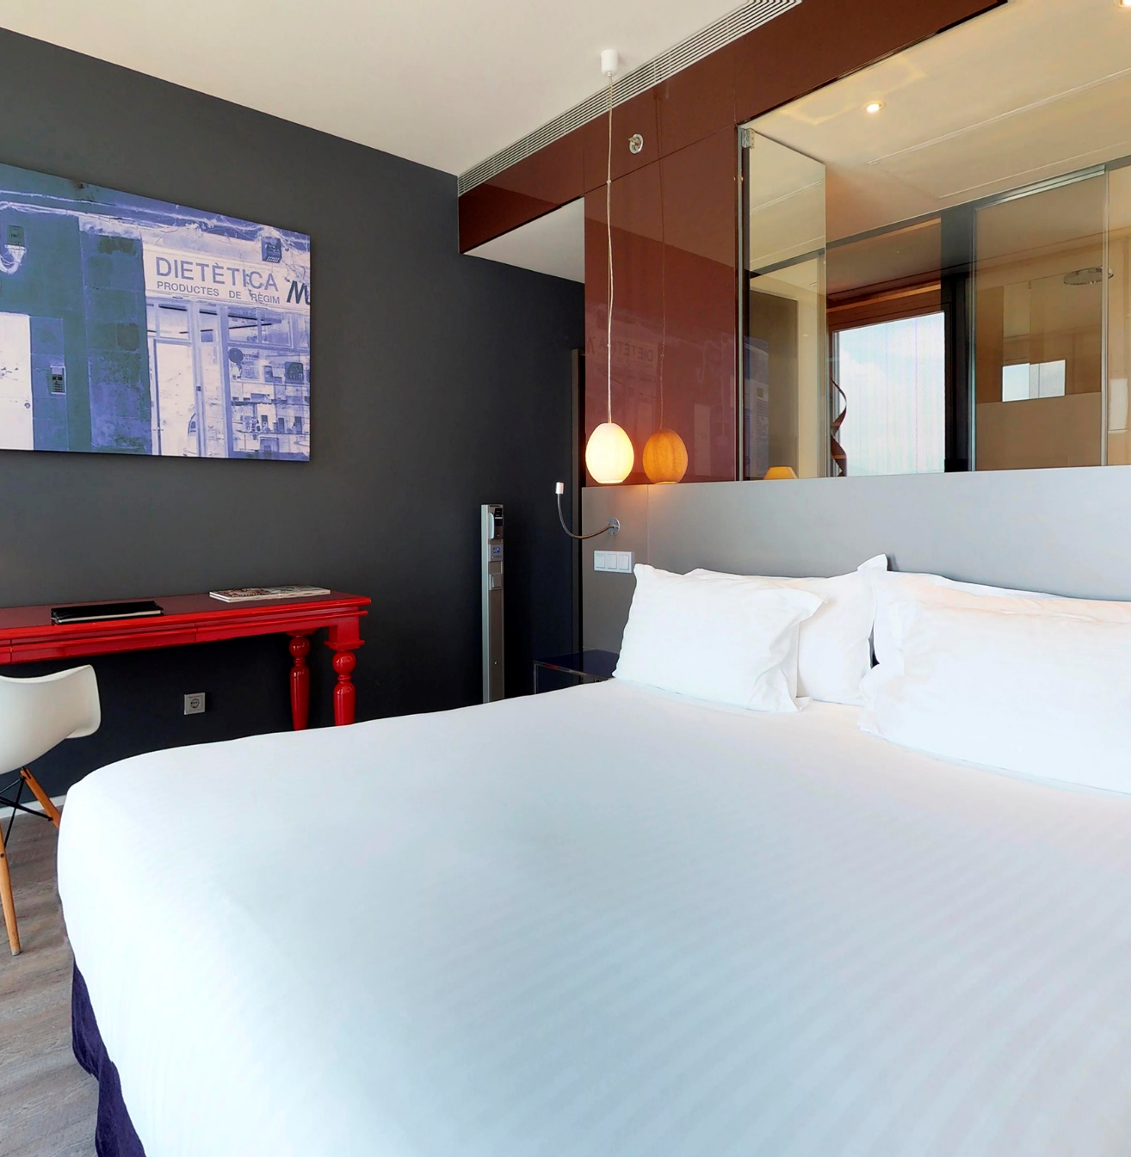
The Level Room
MELIÁ BARCELONA SKY
1 King-size bed or two single beds | 25 m² – Option for a family room (2 connecting rooms | 50 m²). Total of 29 rooms.
An ideal room for a getaway. It features a modern bedroom, a 32" flat-screen TV, a rain-effect shower, a desk area, and panoramic views of Barcelona.

Slide 12
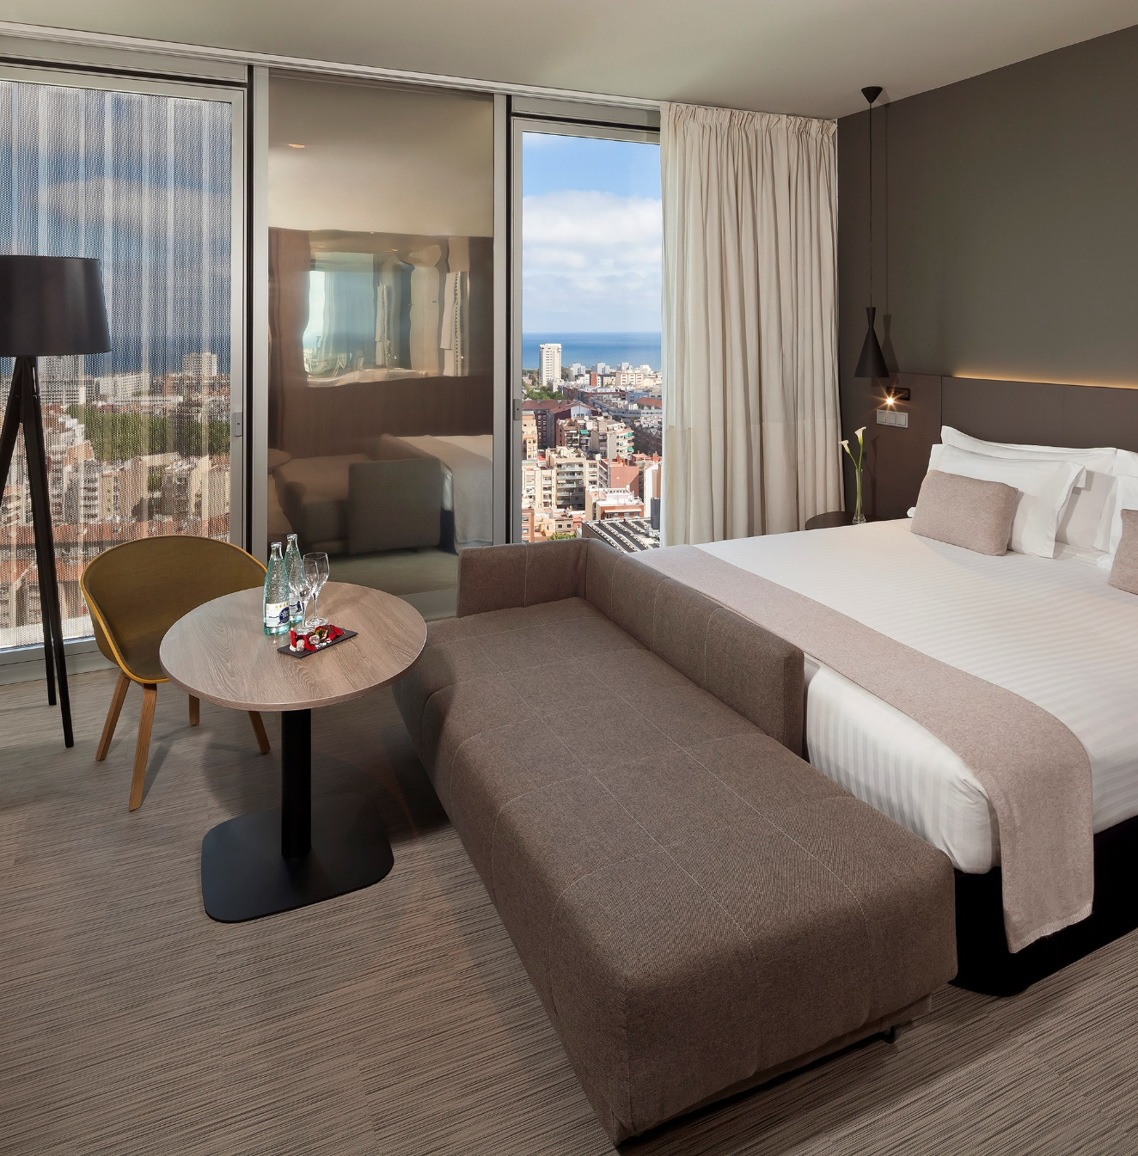
The Level Grand Premium Room City View
MELIÁ SERRANO
1 King-size bed or two single beds | 25 m² – Option for a family room (2 connecting rooms | 50 m²). Total of 52 rooms.
Located on the hotel's highest floors, this room shines with its own light. It features large designer windows, a bedroom with top-quality furnishings, and a glass-enclosed bathroom with a rain-effect shower.

Slide 13
The Level Grand Premium Room Sea View
MELIÁ BARCELONA SKY
1 King-size bed or two single beds | 30 m² – Option for a family room (2 connecting rooms | 60 m²). Total of 25 rooms.
This splendid room with panoramic sea views features a comfortable bedroom, a 55” flat-screen TV, and a full bathroom to start your day off right.

Slide 14
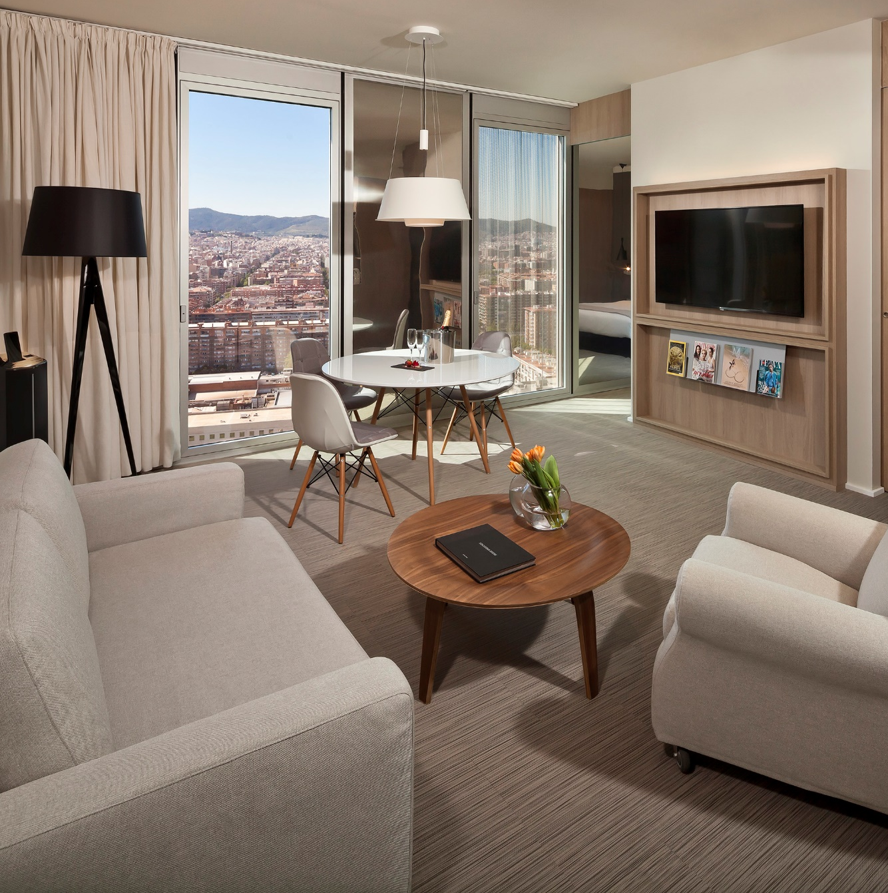
The Level Suite Room City View
MELIÁ BARCELONA SKY
1 King-size double bed | 50 m² - Option for a family room | 50 m². A total of 13 rooms.
This suite, located at the highest point of the hotel, not only offers the best panoramic views of the city but also features a bedroom, a separate living room, and a bathroom with a glass wall.

Slide 15
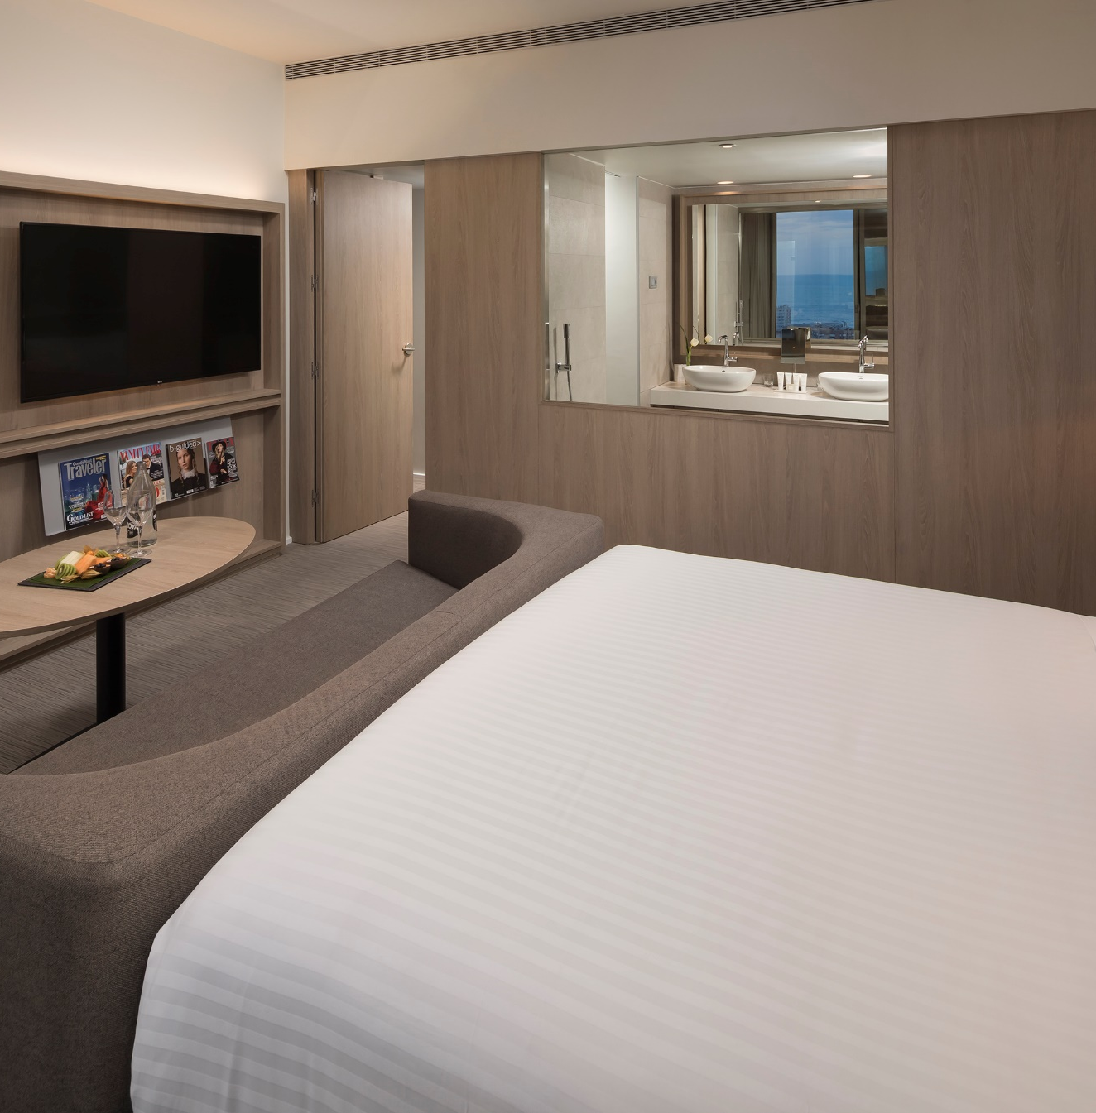
The Level Suite Room Sea View
MELIÁ BARCELONA SKY
1 King-size double bed | 70 m². A total of 7 rooms.
Spectacular room with views of the Mediterranean. It features a luxurious, fully equipped bedroom, a bright separate living room, and a bathroom with a bathtub.

Slide 16
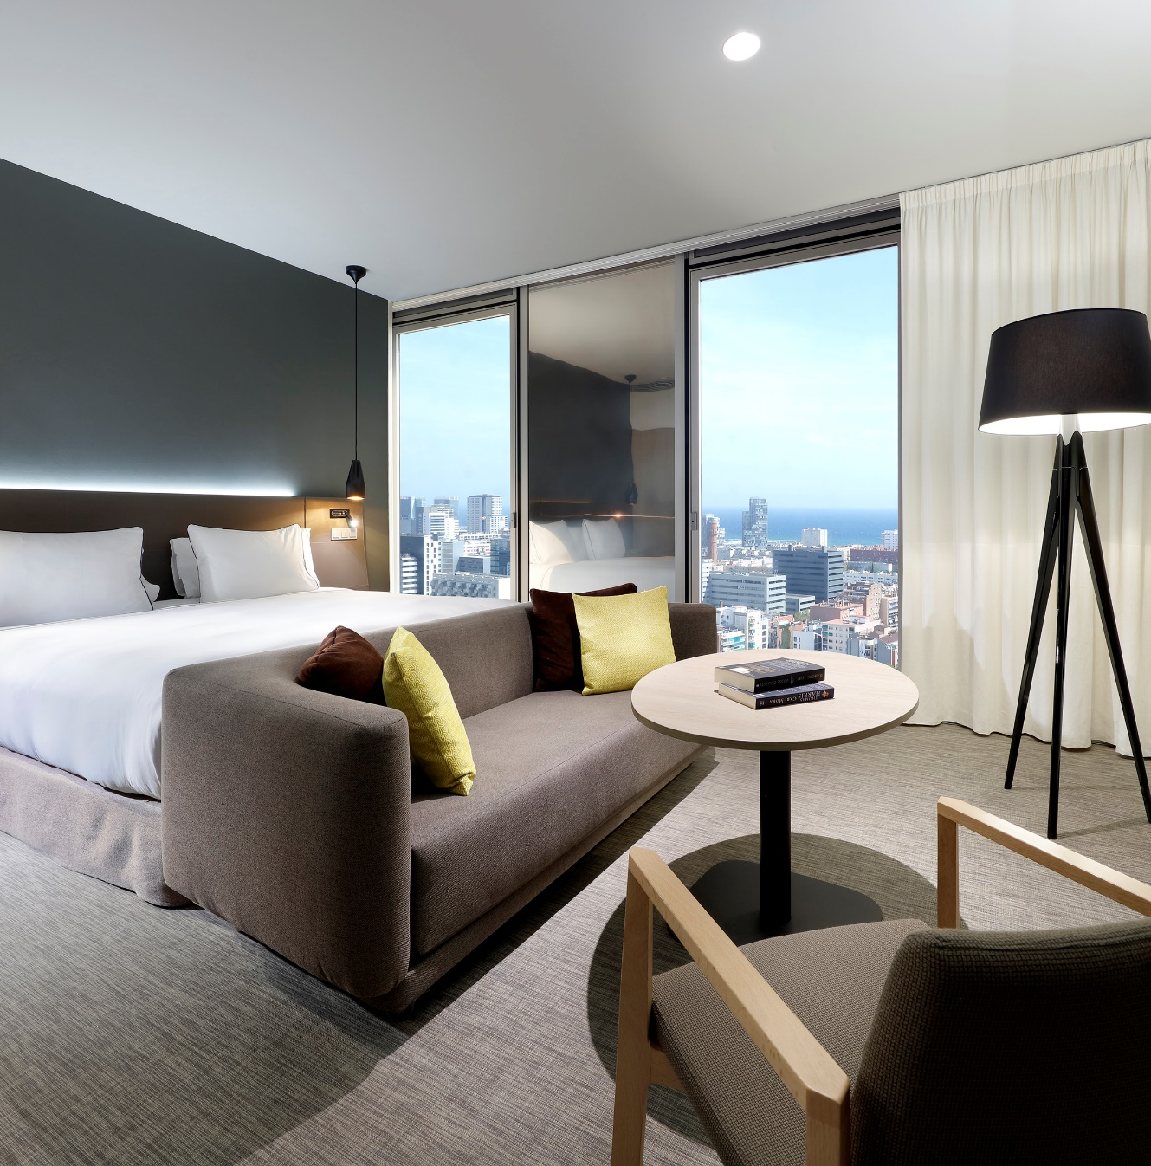
The Level Master Suite Room Sea View
MELIÁ BARCELONA SKY
1 King-size double bed | 80 m²
A suite that exceeds all expectations. Located on the 23rd floor, this luxurious space features a spacious dining area, a living room, a bedroom with a large bed, and a bathroom equipped with a bathtub.

Slide 17
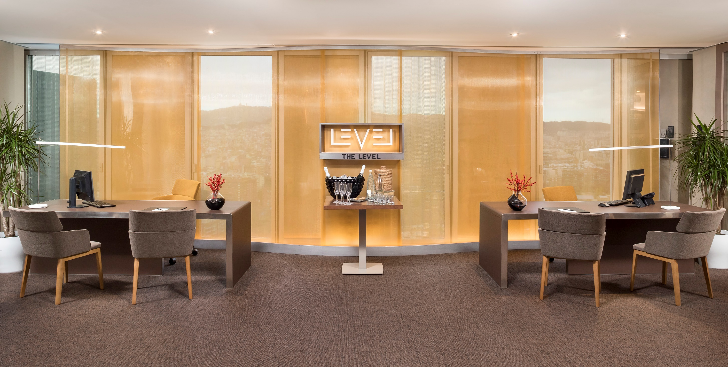
02
The Level

Slide 18
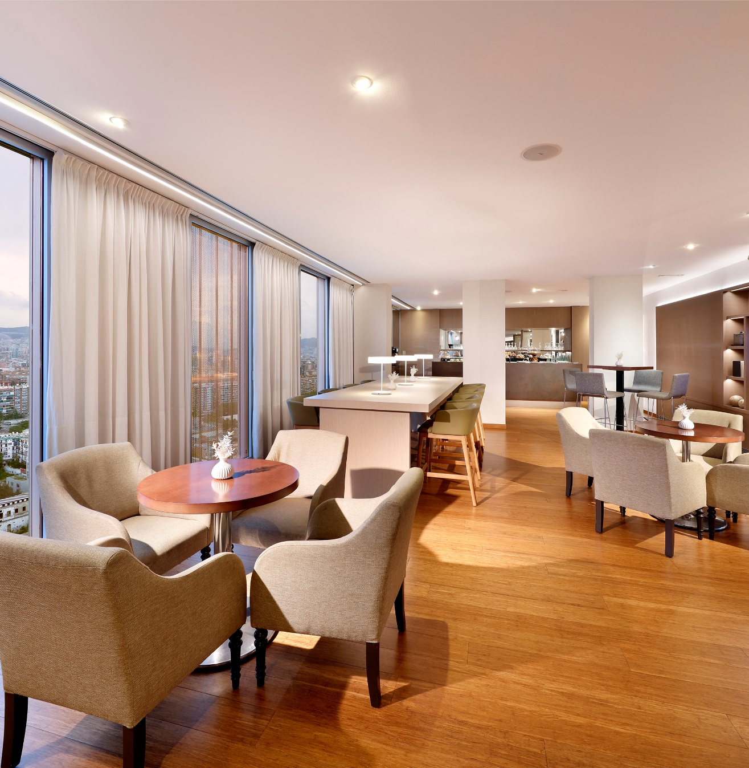
The Level Lounge
MELIÁ BARCELONA SKY
Designed to meet the highest expectations of our guests, The Level offers the most personalized service with the most exclusive amenities.
It features a private lounge and concierge service, a wide selection of daily snacks, as well as additional services in premium areas. Our 5-star hotel is located in a prime area.
.

Slide 19
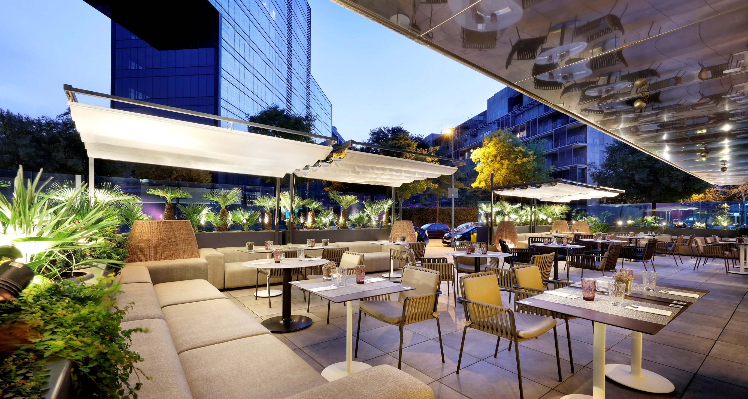
03
Gastronomic Experience

Slide 20
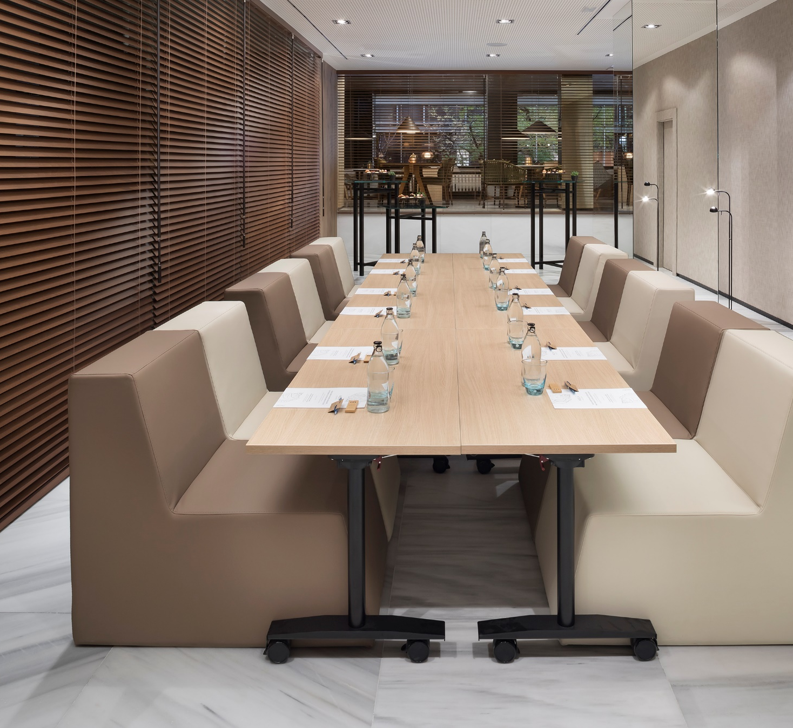
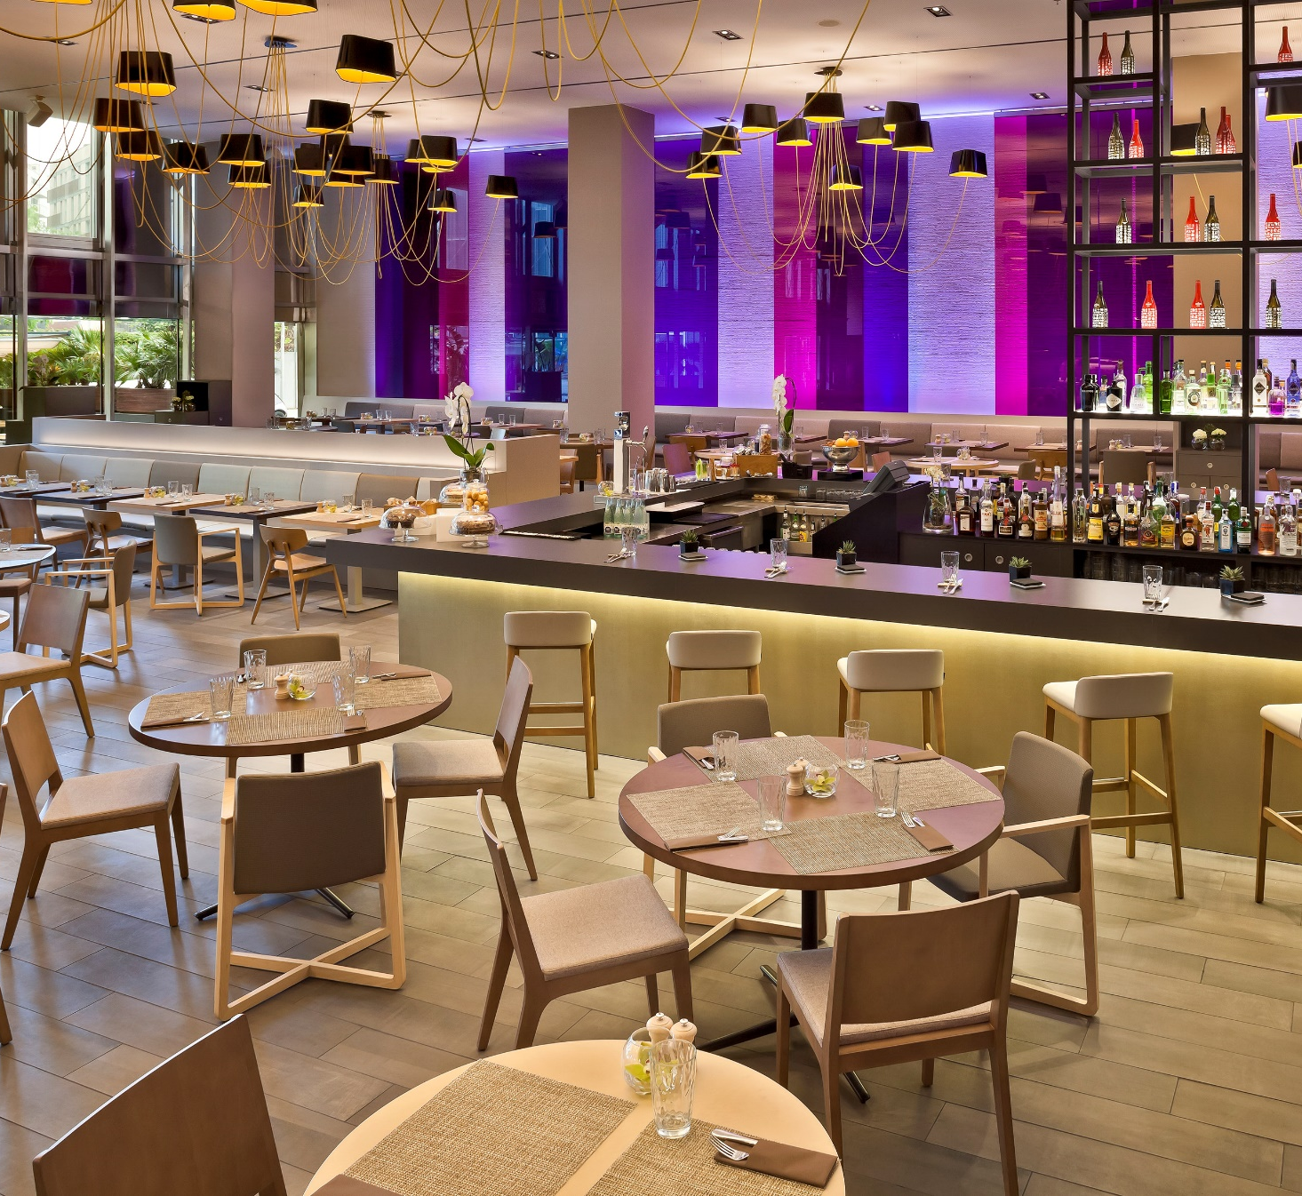
MELIÁ BARCELONA SKY
MERKADO
The Merkado Restaurant is the hotel's culinary hub, where guests can enjoy breakfast, lunch, and dinner. Our dining concept is rooted in the pleasure of Mediterranean cuisine, experienced in a modern and relaxed atmosphere.
The bar also offers a selection of the finest Spanish wines and a wide range of premium drinks, which guests can enjoy indoors or on our beautiful terrace—perfect for afterwork events.

Slide 21
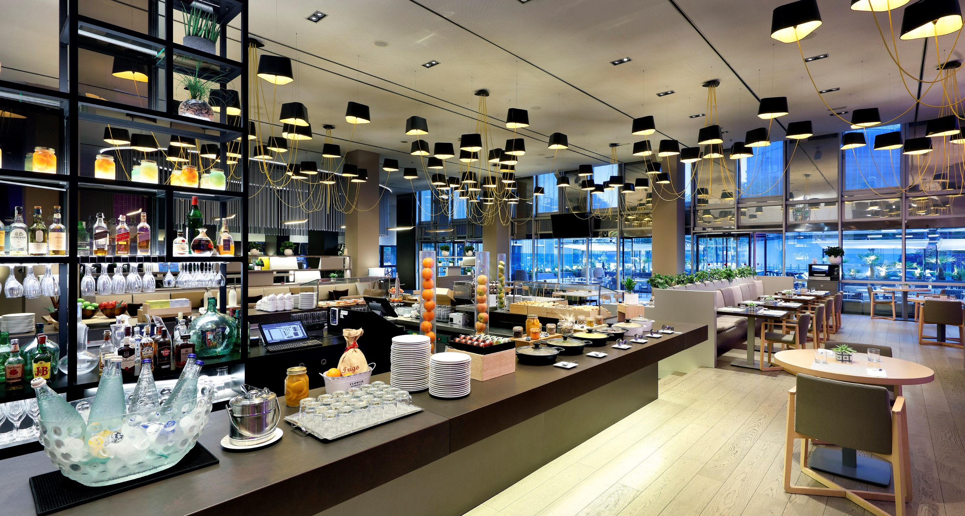

Slide 22
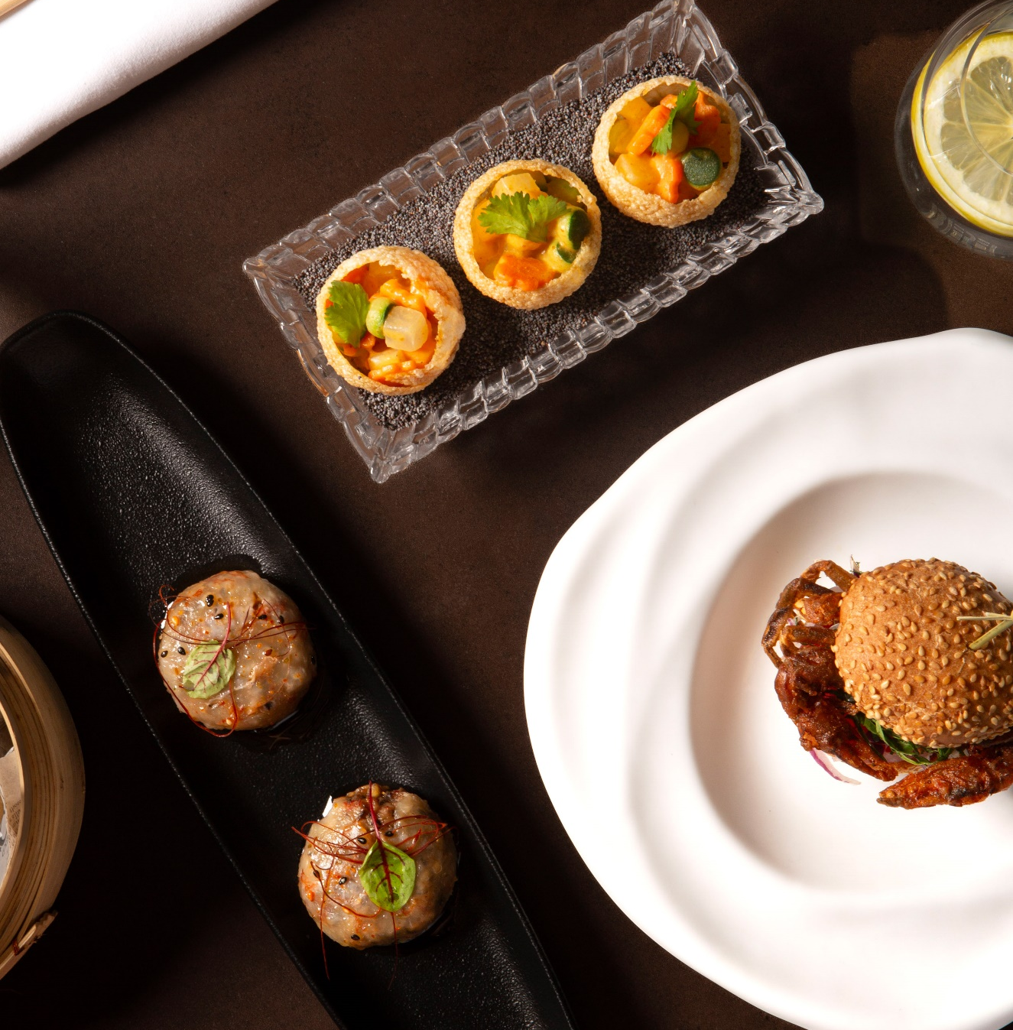
24 Cielos Bar & Restaurant
MELIÁ SERRANO
24 Cielos is the perfect spot to admire Barcelona's stunning skyline, enjoy the city's highest breakfast, and marvel at a beautiful sunset with a 360-degree view of the "Ciudad Condal" and the Mediterranean Sea.
An ideal way to end the workday in a relaxed yet sophisticated atmosphere, on Barcelona's highest terrace, where you can savor a delightful selection of gourmet and fusion tapas.

Slide 23
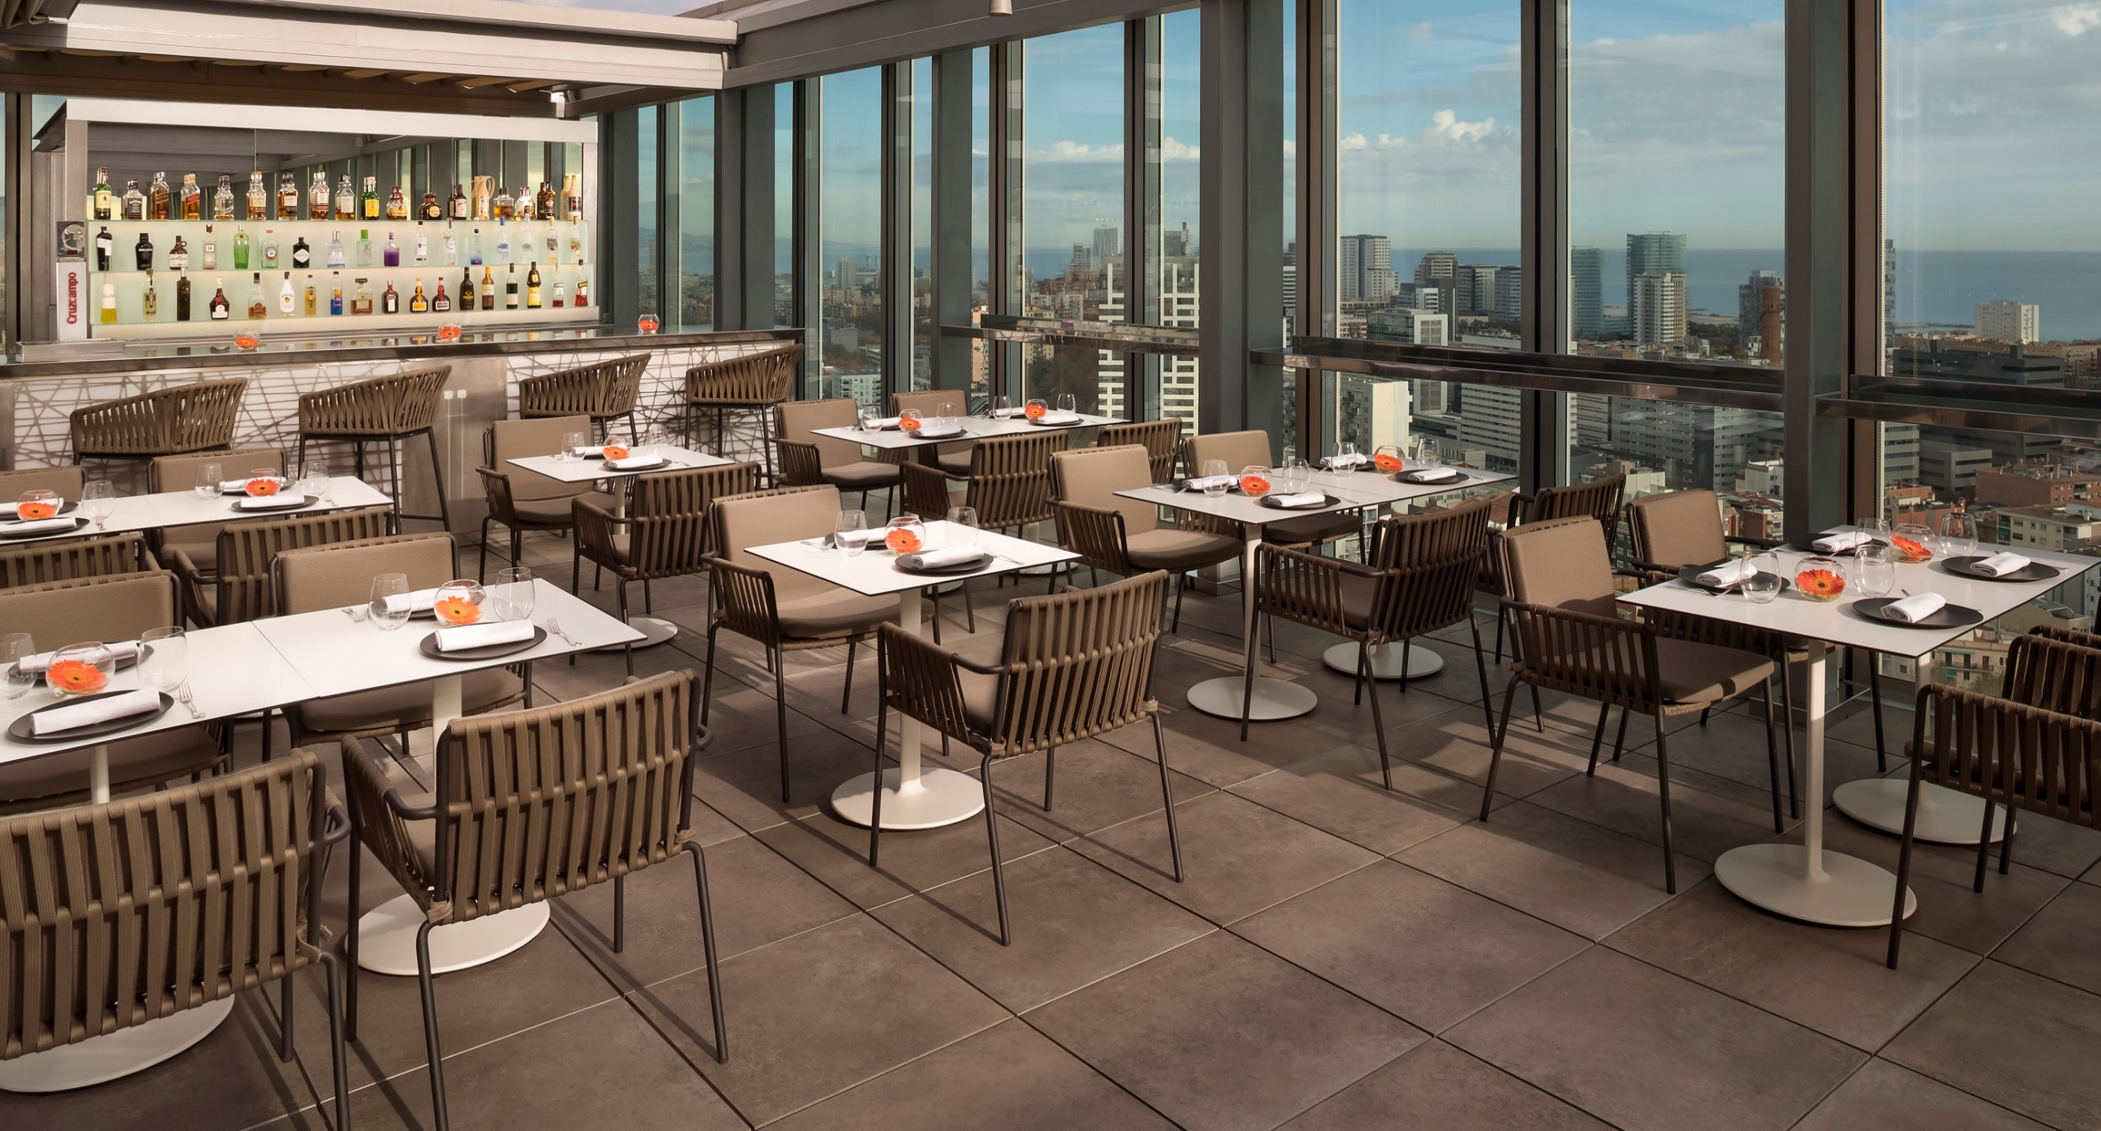

Slide 24
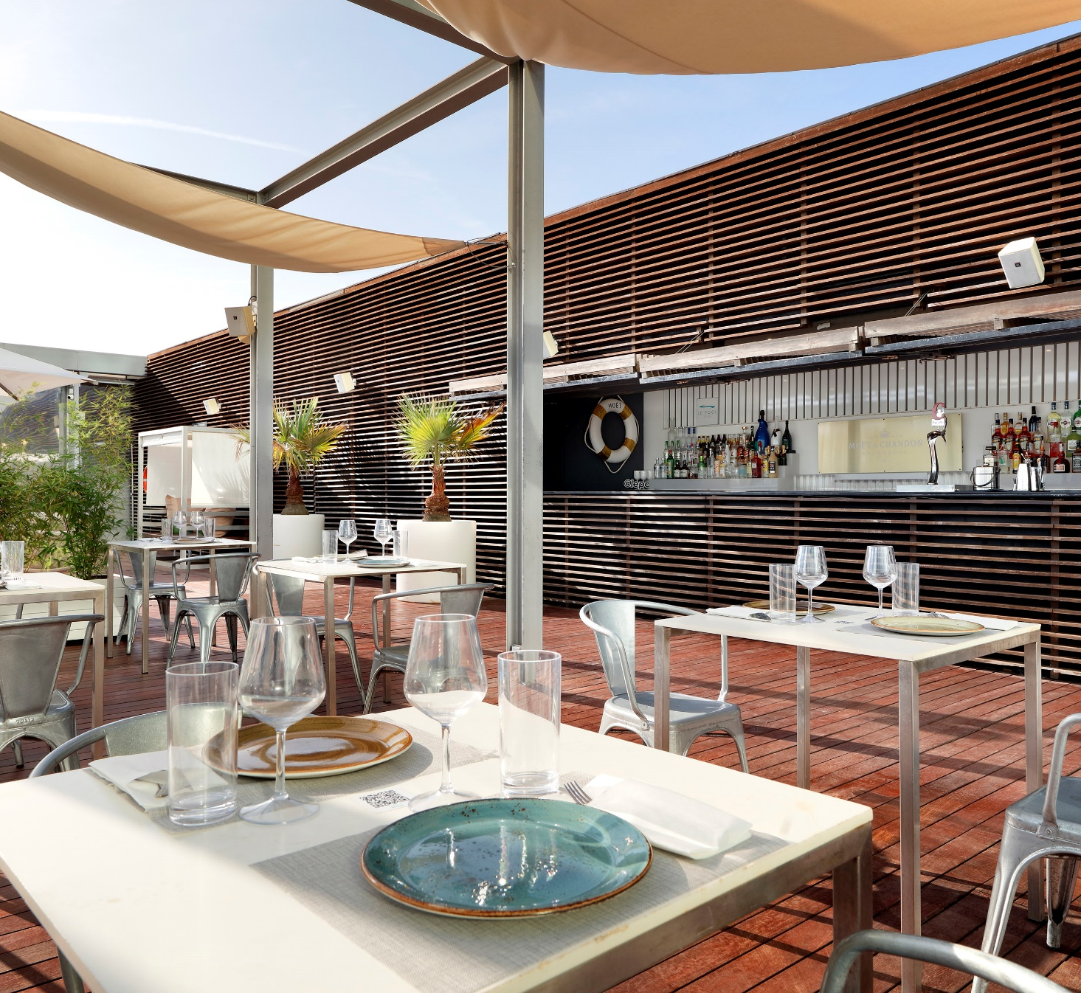
MELIÁ BARCELONA SKY
POOL BAR
Our pool, located on the sixth floor of the Meliá Barcelona Sky hotel, features a spacious and exclusive pool-terrace area. Music enthusiasts can enjoy live performances while savoring our delicious selection of cocktails, tapas, and the finest salads.

Slide 25
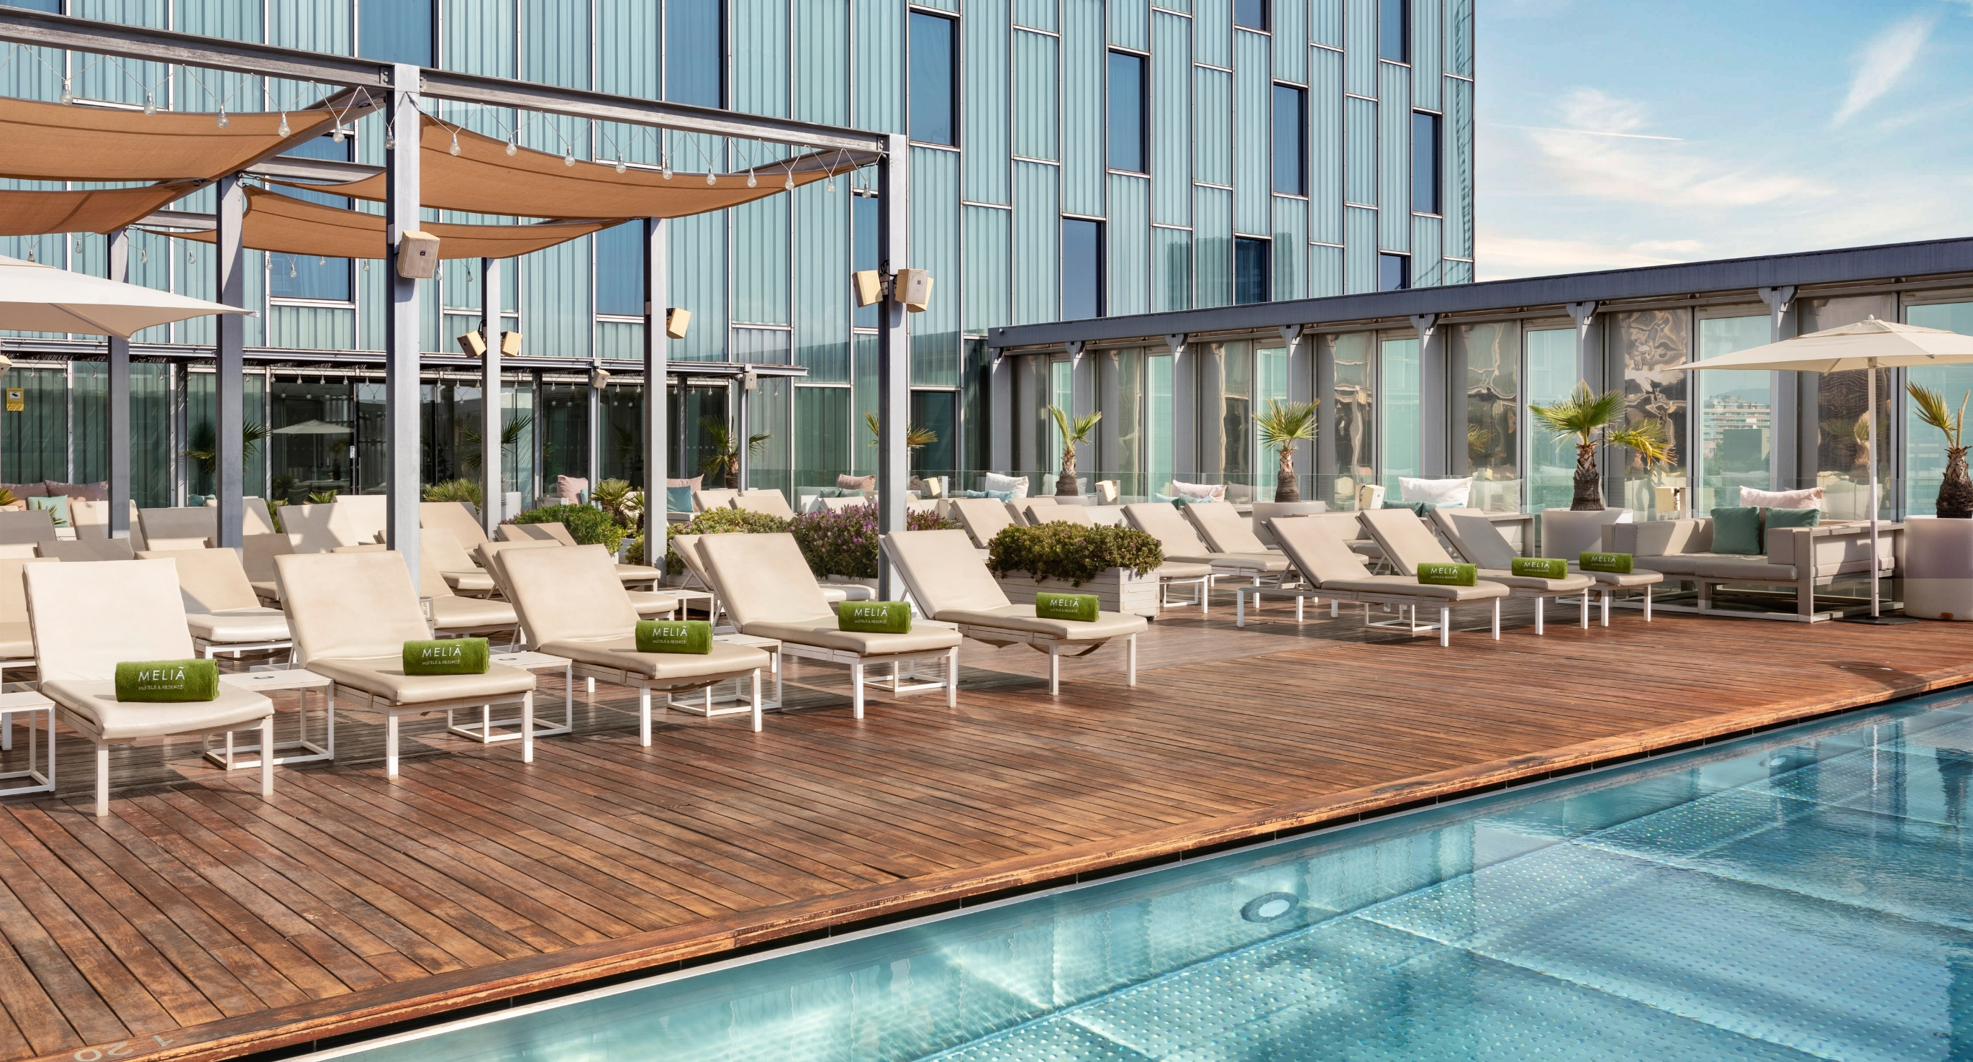

Slide 26
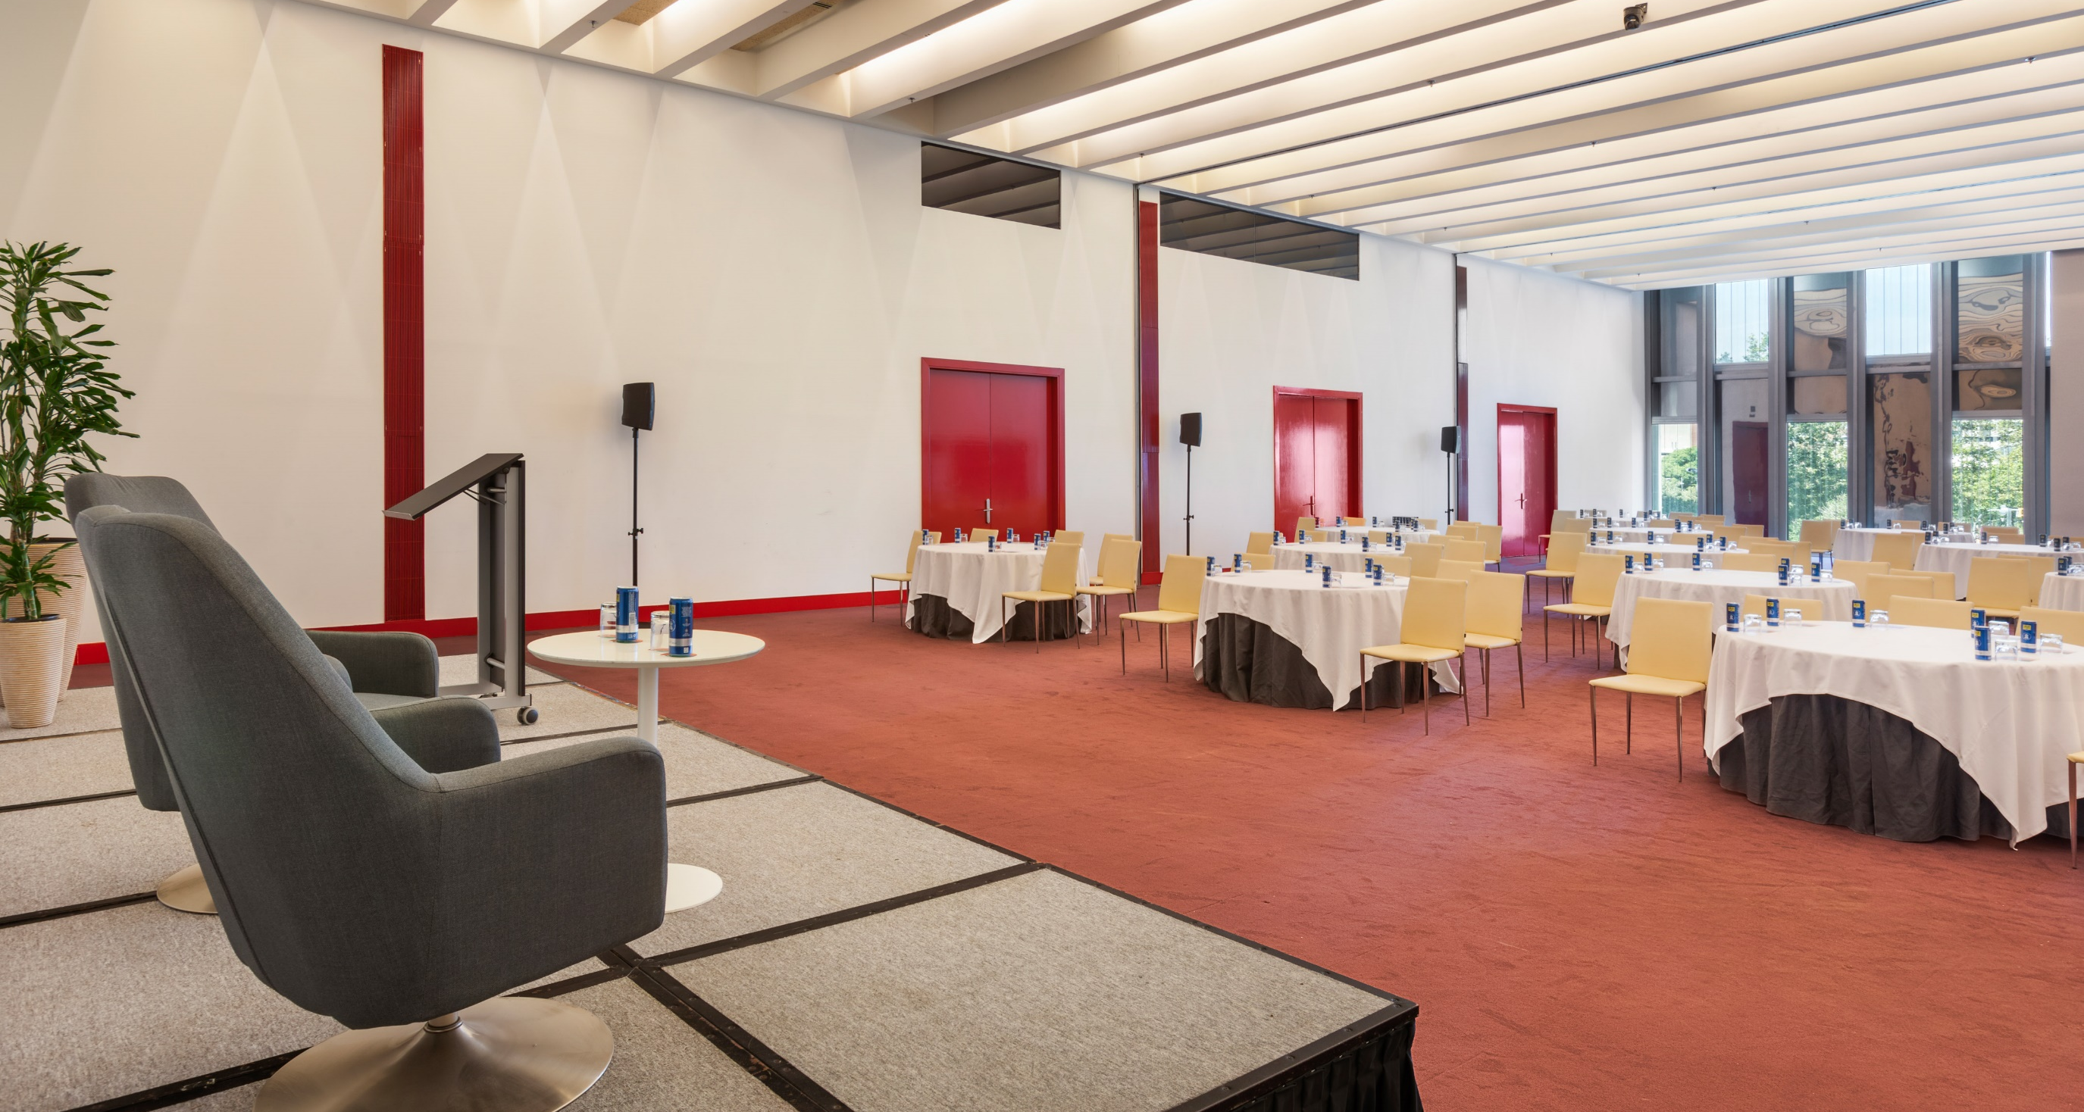
04
Power Meetings

Slide 27
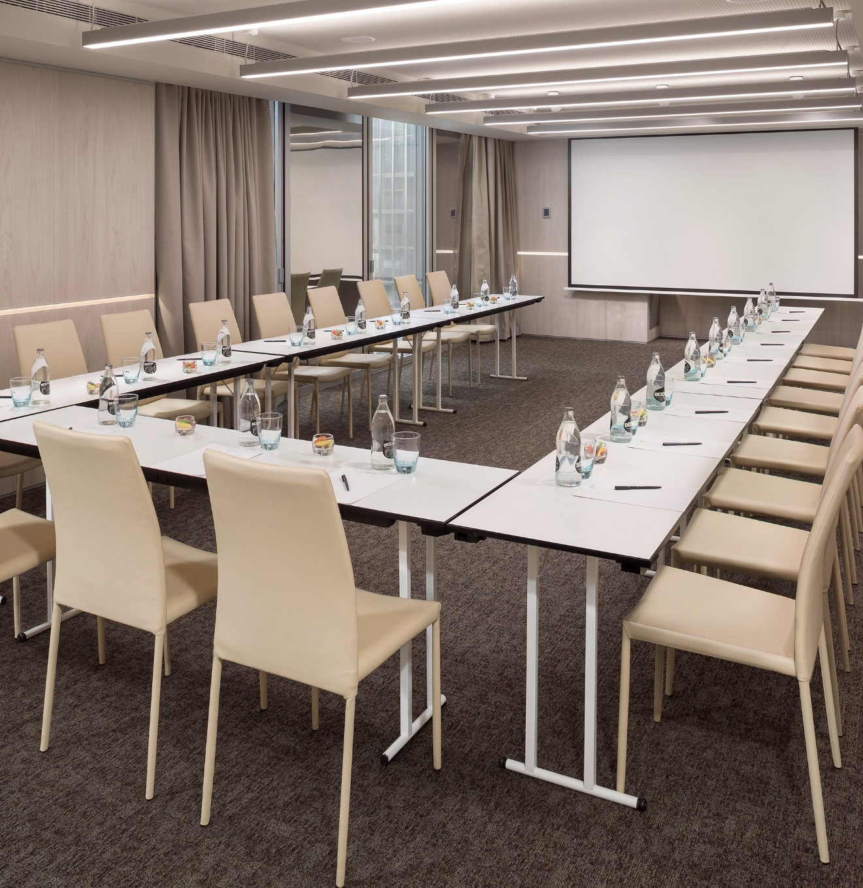
MELIÁ BARCELONA SKY
We offer 14 elegant and innovative meeting rooms with a maximum capacity of 360 people.
These include rooms with natural light, high ceilings, multiple spaces, alternative coffee break areas, 4 terraces, and high-speed internet with WiFi.

Slide 28
MELIÁ BARCELONA SKY
 | Sq.m. | Theater/Teatro | Classroom/Aula | Banquete/Banquet | Cabaret | U- shape/Estilo U | Imperial/Boardroom | Cocktail
Planta -1 Floor -1
Studio 1 | 87 | 60 | 36 | 48 | 25 | 24 | 24 | .
Studio 2 | 38 | 30 | 18 | 24 | 10 | 15 | 15 | .
Studio 3 | 43 | 30 | 18 | 24 | 10 | 15 | 15 | .
Studio 4 | 40 | 30 | 24 | 24 | 10 | 15 | 15 | .
Studio 5 | 37 | 30 | 24 | 24 | 10 | 15 | 15 | .
Studio 1-3 | 170 | 130 | 80 | 96 | 55 | 39 | . | 125
Studio 2-3 | 79 | 60 | 42 | 48 | 20 | 30 | 30 | 60
Studio 4-5 | 80 | 60 | 36 | 56 | 20 | 30 | 30 | 65
Studio 1-5 | 320 | 280 | 168 | 224 | 135 | 78 |  | 280
Planta 2 2nd Floor
Sky 1 | 93 | 80 | 48 | 60 | 30 | 30 | 30 | 70
Sky 2 | 98 | 80 | 48 | 60 | 30 | 30 | 30 | 75
Sky 3 | 158 | 140 | 69 | 90 | 45 | 36 | 30 | 120
Sky 1-2 | 192 | 180 | 96 | 100 | 70 | 45 | . | 140
Sky 2-3 | 257 | 230 | 120 | 150 | 80 | 56 | . | 220
Sky 1-3 | 353 | 300 | 235 | 250 | 125 | 75 | . | 300
Planta 3 3rd Floor
Cloud 1 | 55 | 48 | 30 | . | 15 | 21 | 21 | .
Cloud 2 | 56 | 48 | 30 | . | 15 | 21 | 21 | .
Cloud 3 | 25 | 15 | 9 | . | . | 9 | . | .
Cloud 4 | 51 | 30 | 18 | . | . | 21 | . | .
Cloud 1+2 | 111 | 100 | 60 | . | 35 | . | . | .
Cloud 3+4 | 76 | 60 | 24 | . | 25 | 27 | . | .
Planta 4 4th Floor
Evolution | 306 | 200 | 126 | 180 | 75 | 45 | . | 280
Library | 33 | 24 | 18 | 32 | 15 | . | 15 | 30

Slide 29
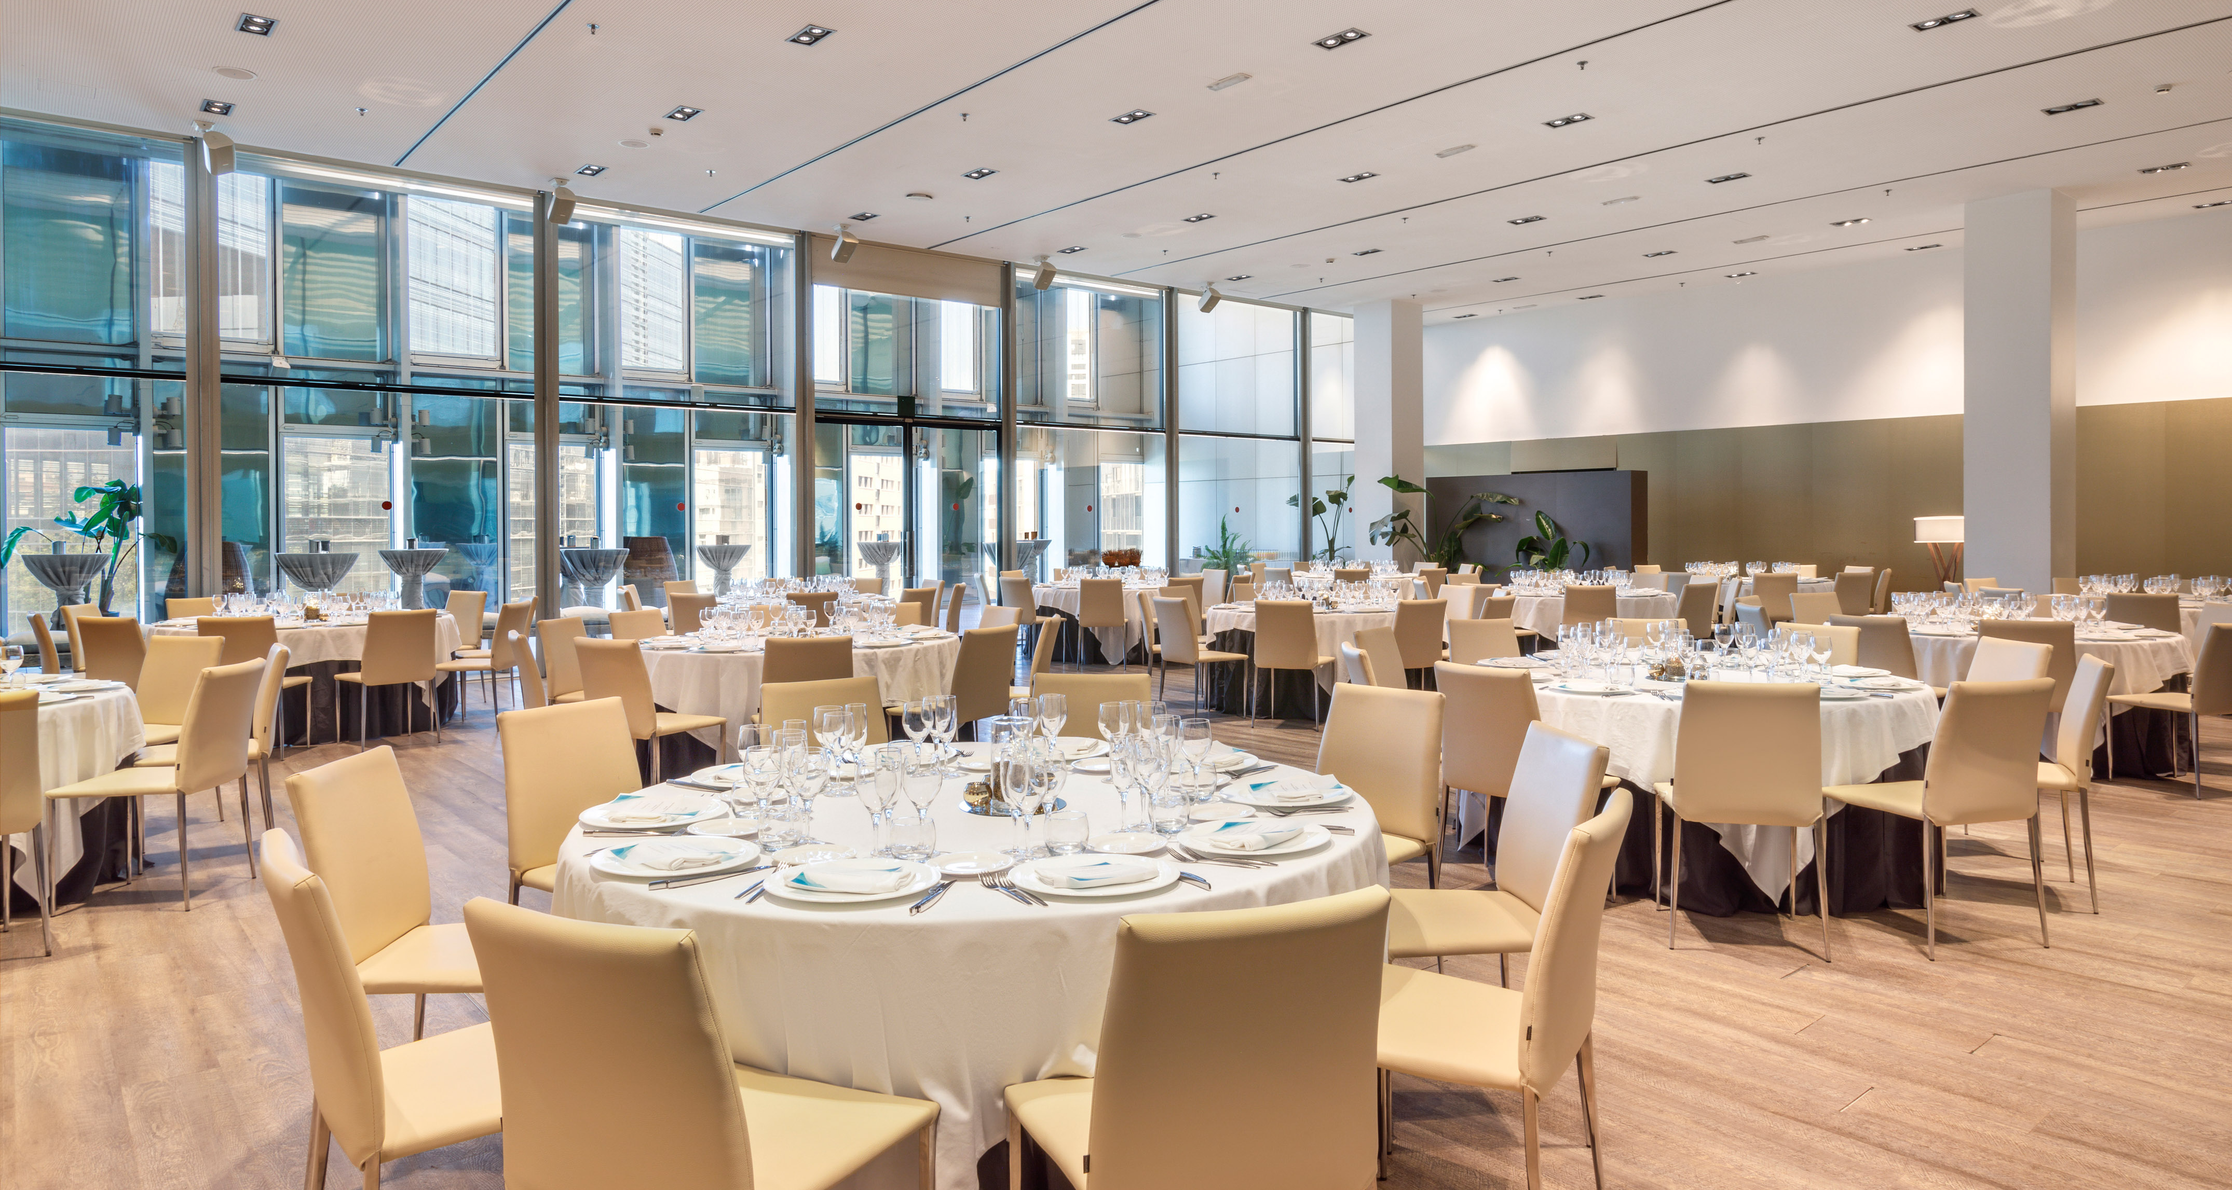

Slide 30
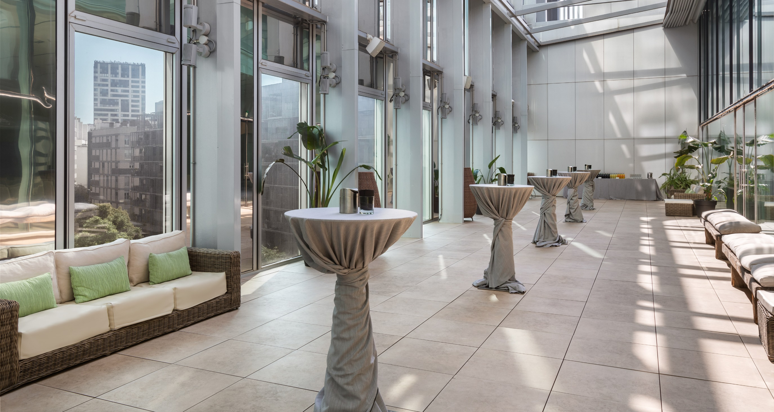

Slide 31
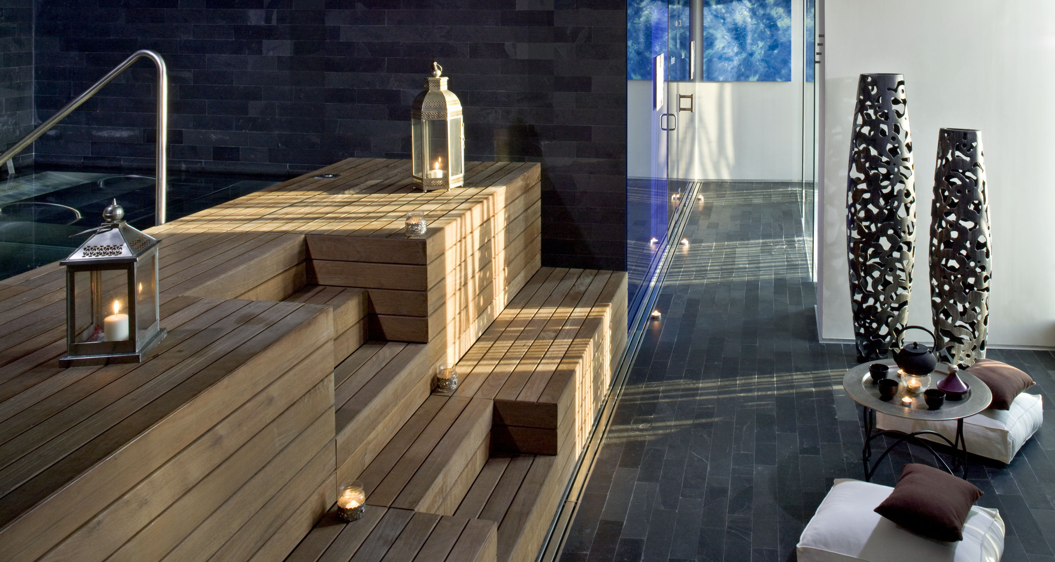
05
Other facilities

Slide 32
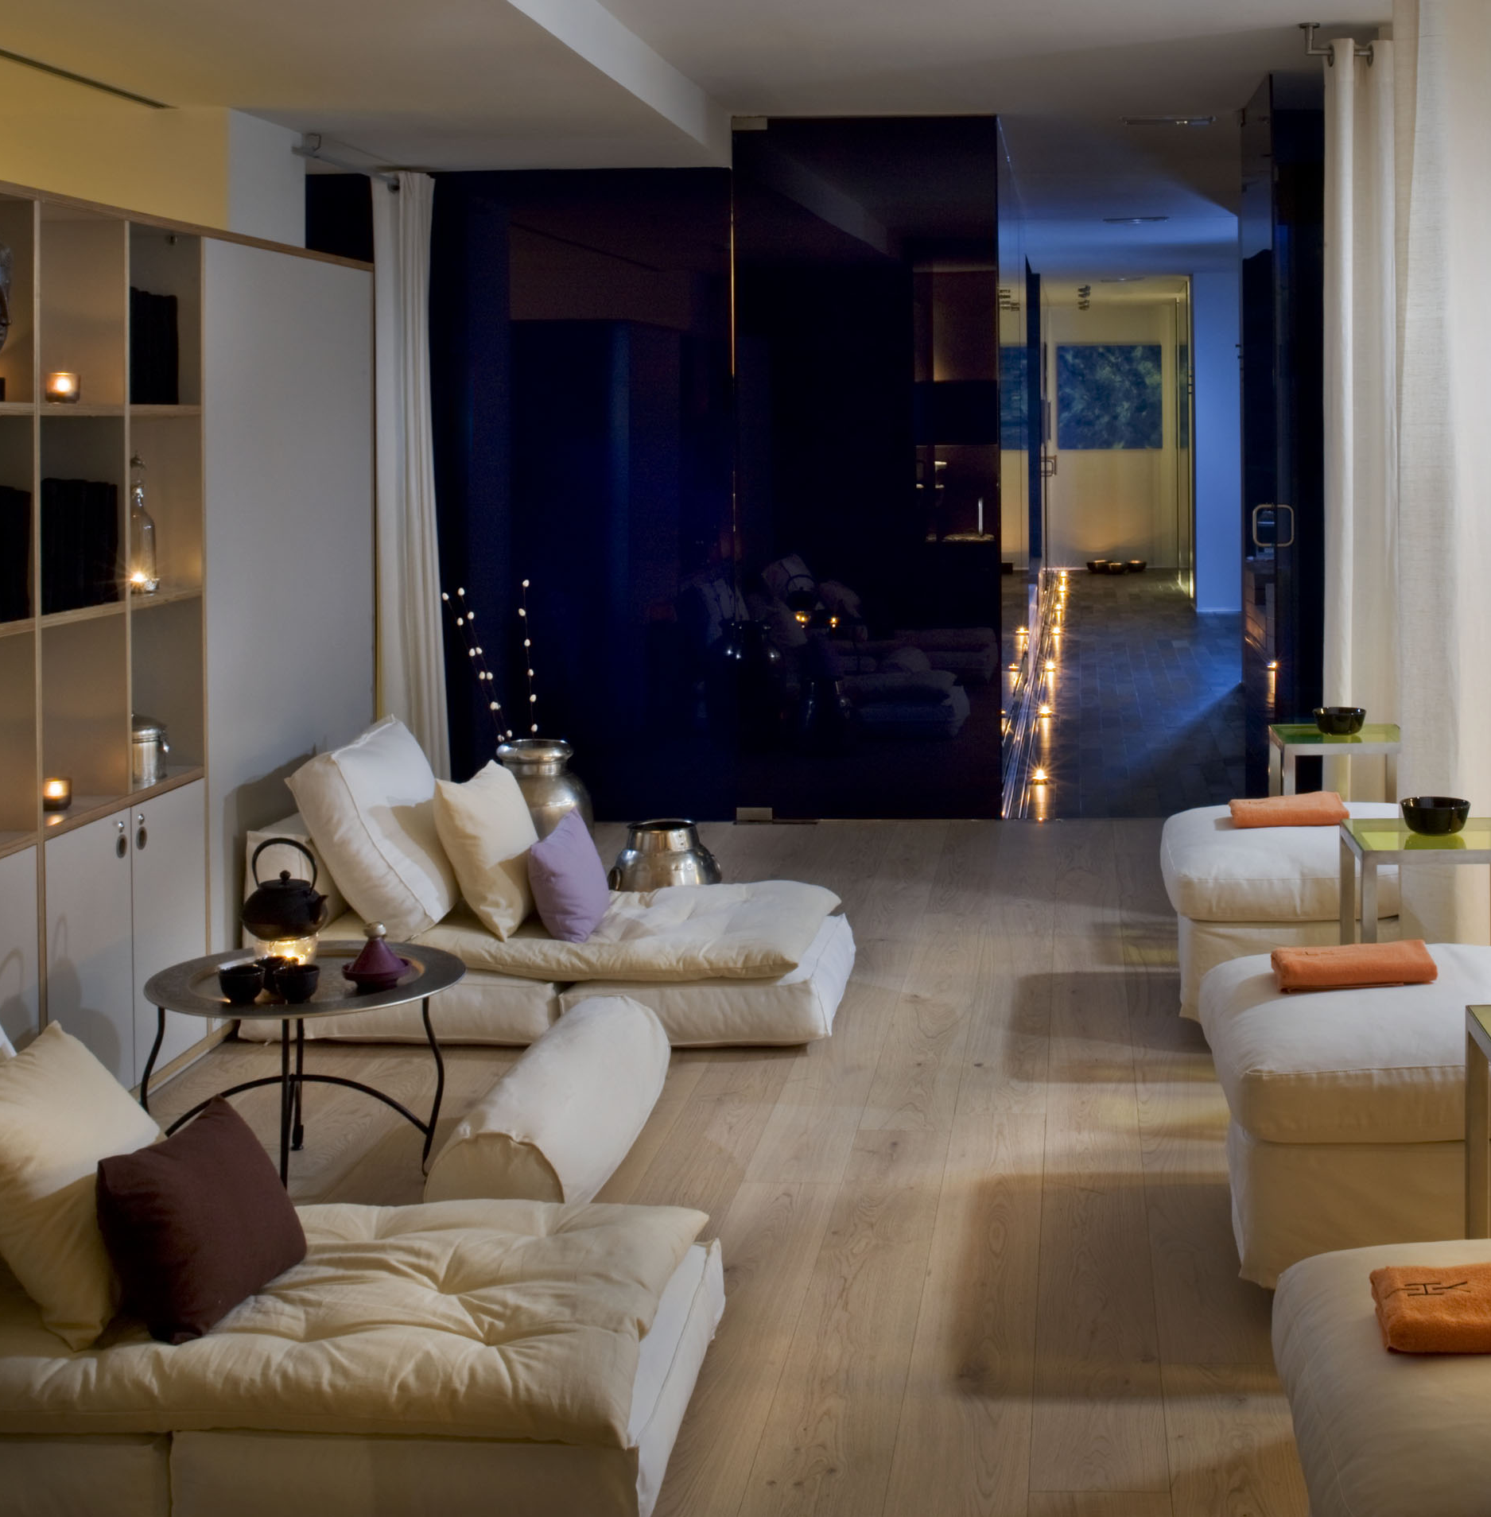
Serena Spa
MELIÁ BARCELONA SKY
At Serena Spa, we embrace wellness from a holistic perspective. We specialize in enhancing beauty, body, and mind to achieve personal balance, unwind, and take time for yourself. A space designed to rejuvenate, relax, and find the peace you need.

Slide 33
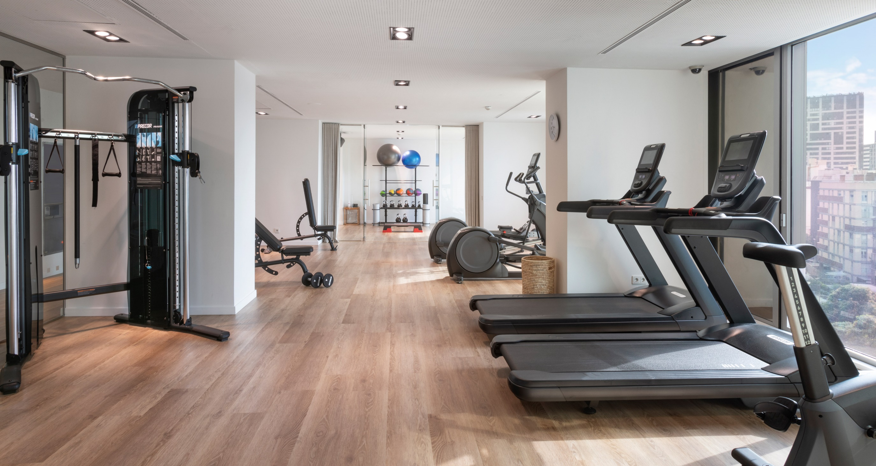

Slide 34
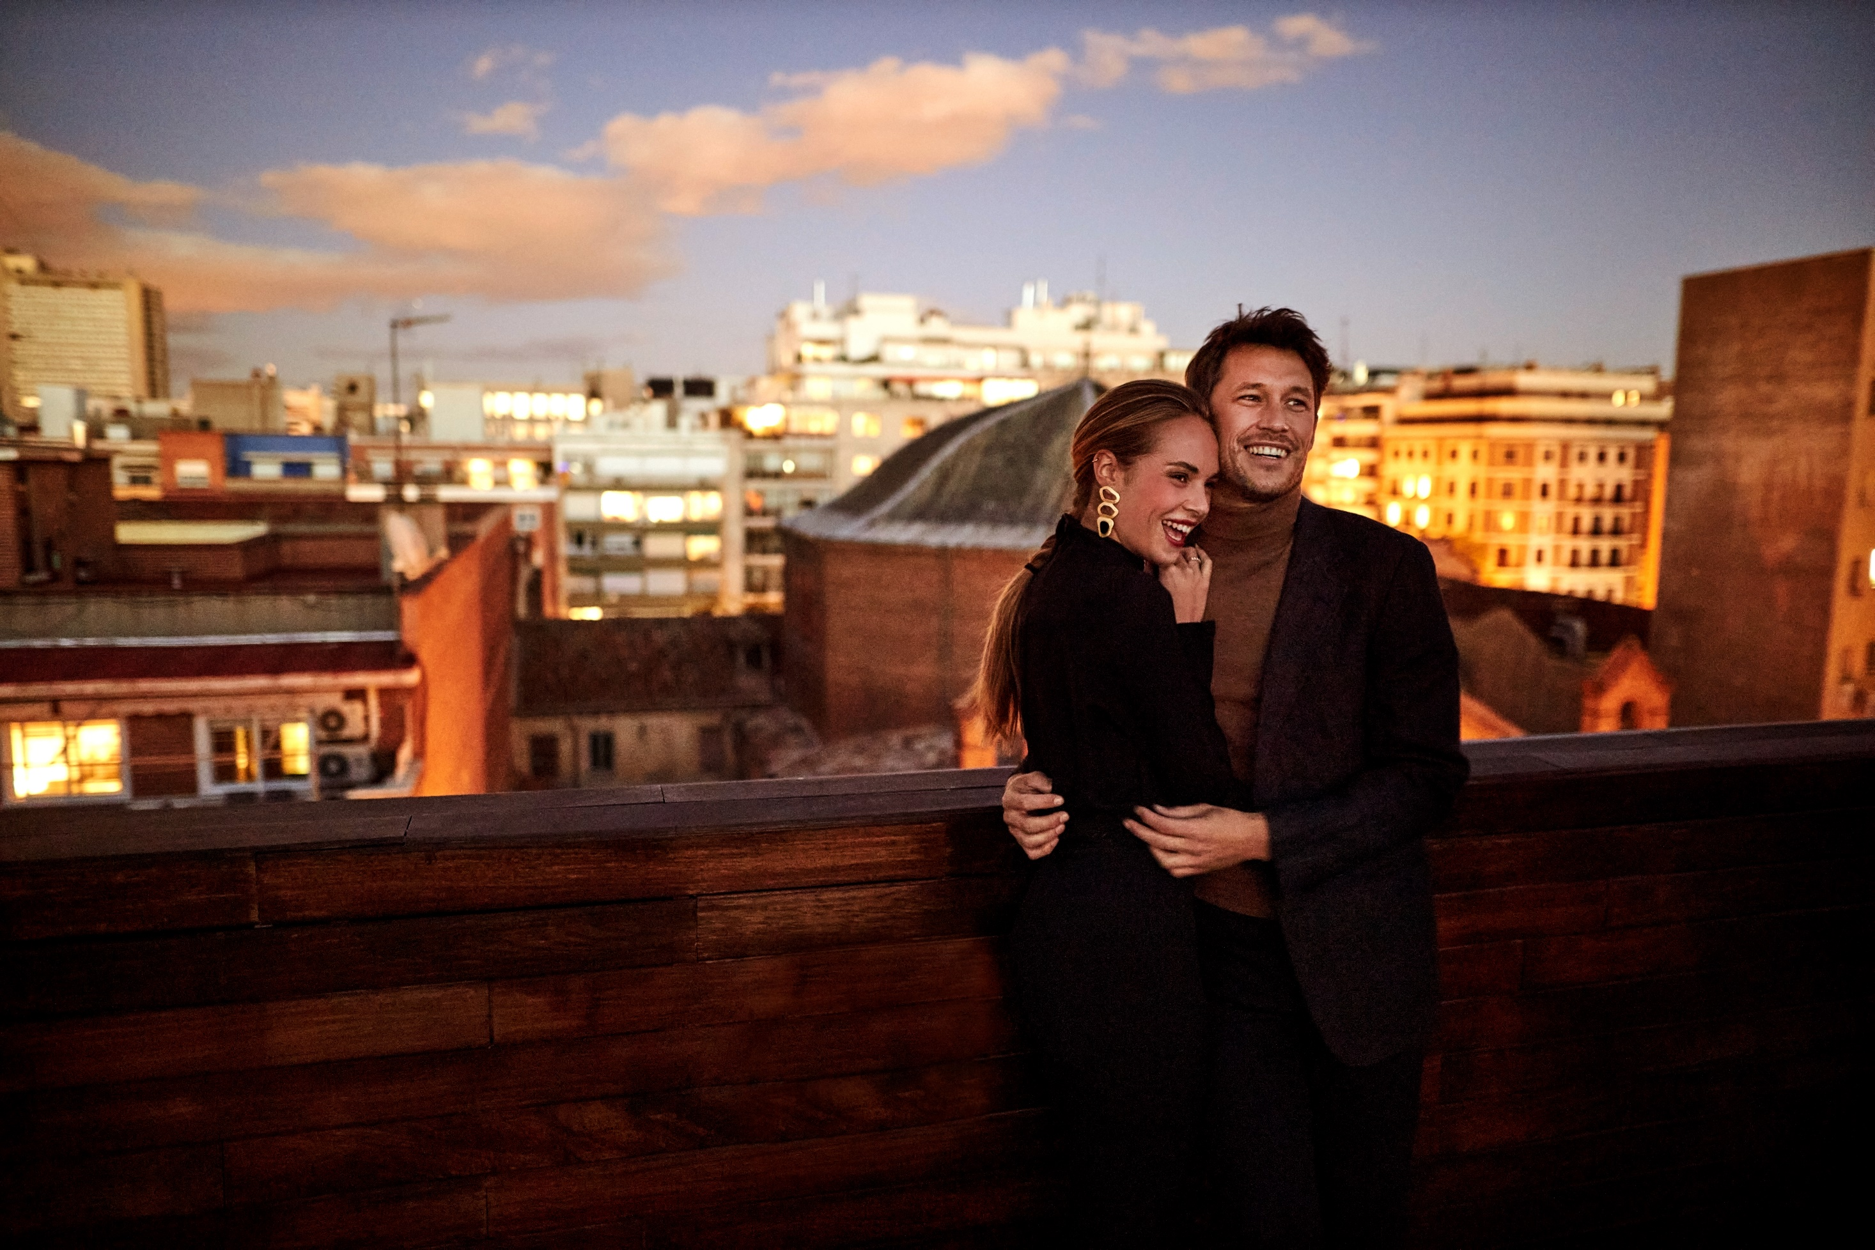
melia.com

